Slide 2
Thank you to our Sponsors!

Slide 3
Plato, Luddites and Assessments CNG session on Generative AI
Notes:
Elisa (<1 minute)

Slide 4
Today’s Speakers
Eric H. D’Astolfo – Vice President, Business Development, Pearson VUE As Vice President of Business Development, Eric D’Astolfo is responsible for business development and client management activities for Pearson VUE’s professional licensure and certification markets. Eric has nearly 30 years of experience in both the K–12 and certification testing industries, including test development, business development, and program management. Prior to Pearson VUE, Eric served in a variety of leadership roles with The Princeton Review Canada, Harcourt Publishers, the American Board for Certification of Teacher Excellence and the Scantron Corporation. An active contributor to industry associations and committees, he has served as both conference chair of the Innovations in Testing conference in 2016 and also as a member of the Board of Directors for the Association of Test Publishers (ATP) in 2017. Eric earned an Master’s Degree in English and American literature from the State University of New York at Buffalo and a BA in English Literature from New York University.
Notes:
Elisa

Slide 5
Today’s Speakers
Dr. Kirk Becker – Senior Research Scientist, Pearson VUE
Dr. Becker is a senior research scientist with Pearson. He has over twenty five years experience conducting research and performing operational work in measurement and psychometrics. Kirk has conducted research and worked operationally with test security and data forensics, automatic item generation, applications of natural language processing to testing, innovative test items, and exam formats (CAT, LOFT, and MST). Dr. Becker received his Ph.D. in Educational Psychology from the University of Illinois at Chicago.
Notes:
Elisa

Slide 6
Today’s Speakers
Ken Alba – Head of Product, Trivie and Chief Product Officer, electropath.io
Ken Alba is a dynamic product management leader, serving as the Head of Product at Trivie and the Chief Product Officer at electropath.io. Ken's background is academic, with advanced degree in English Literature from Boston University and a postgraduate fellowship at MIT's Digital Humanities Lab where he worked on extracting structured metadata from unstructured texts. Ken's current endeavor revolves around pioneering a groundbreaking tool that generates innovative assessment material from diverse unstructured sources, such as PDFs, videos, and websites. His passion for pushing boundaries extends beyond his professional pursuits, as he is an ardent lover of science fiction.
Notes:
Elisa

Slide 7
Agenda
Some recent and ancient history
What’s everyone saying about generative AI?
Where we’re at now
How will this impact our world?
Demos
Q&A
Notes:
Elisa (<1 minute)

Slide 8
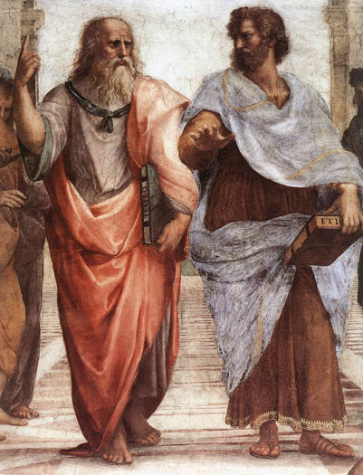
Plato & Writing
“This invention, writing, O king,” said Theuth, “will make the Egyptians wiser and will improve their memories; for it is an elixir of memory and wisdom that I have discovered.”
But Thamus replied, “… you, who are the father of letters, have been led by your affection to ascribe to them a power the opposite of that which they really possess. For this invention will produce forgetfulness in the minds of those who learn to use it, because they will not practice their memory. Their trust in writing, produced by external characters which are no part of themselves, will discourage the use of their own memory within them. You have invented an elixir not of memory, but of reminding; and you offer your pupils the appearance of wisdom, not true wisdom, for they will read many things without instruction and will therefore seem to know many things, when they are for the most part ignorant and hard to get along with, since they are not wise, but only appear wise.”
Notes:
Elisa (<1 minute)

Slide 9
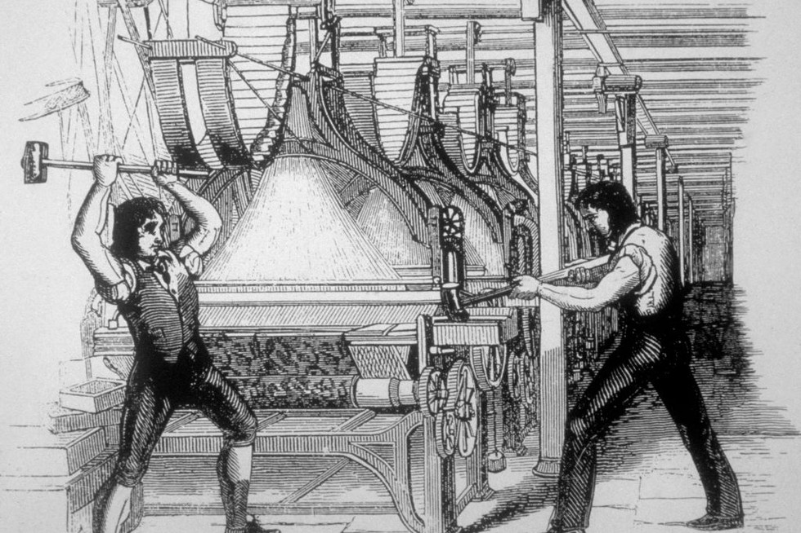
Labor, Automation, Economics
Notes:
Elisa (<1 minute)

Slide 10
The state of NLP (in 2012!)
Automated essay scoring
Automated speech scoring
Automated scoring of short constructed response
Item bank evaluation for content coverage
Automated referencing
Identification of enemy items/content overlap
Item classification
Classification of interviews/narratives/personal histories according to psychological models
Automated item generation
Item writing aides (distractor modeling)
Reading assessment (Metametrics/MUSE)
Sentiment analysis
Item difficulty modeling
Test/Simulation log analysis
Item Selection for Personality Tests
Scale Construction
Notes:
Elisa (<1 minute)

Slide 11
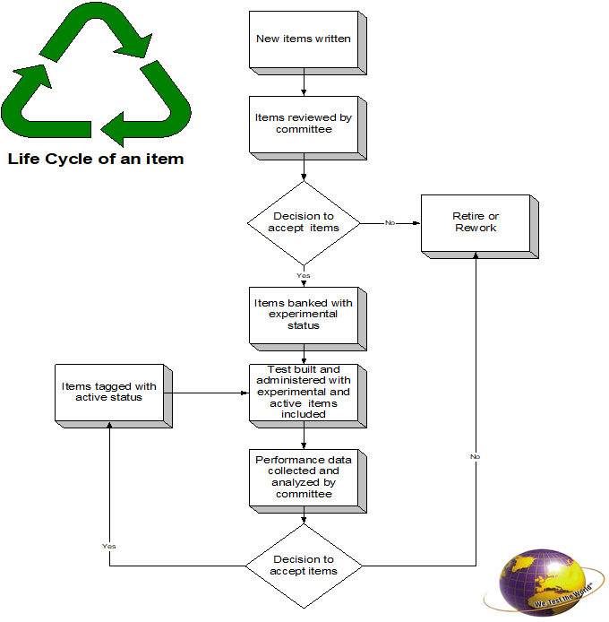
Just moving the bottleneck?
Job Analysis and Construct Definition
Item Writing/Editing
Item analysis/calibration
Standard Setting
Notes:
Elisa (<1 minute)

Slide 12
Definitions & Background
“LLM”
“GPT”
“Fine Tuning”
“RLHF”
Data Sets
The Players
The Problems
Notes:
Elisa (<1 minute)

Slide 13
Why Can’t we Just Push a Button?
Questions about generative AI for item creation:
Content coverage
Relevance
Cognitive level
Difficulty
Format
Quality
Specificity
Correctness
Redundancy
Ownership
Notes:
Elisa (<1 minute)

Slide 14
Psychometric issues
Many psychometricians seem to view items as “the things that generate data”
Very little formal work is done to understand why items perform the way they do
Understanding how knowledge and tasks progress and interrelate in a field is a first step to understanding item performance
This may be part of the development process, or done through classifying/categorizing items or templates
Notes:
Elisa (<1 minute)

Slide 15
What’s Coming Up
Larger Context Windows
RLHF
AI Trained On AI (A Big Problem!)
Multimodality
Compositionality (e.g. Langchain)
Diversity of Providers (OpenAI -> LLM Ecosystem)
What’s Newly Possible?
Notes:
Elisa (<1 minute)

Slide 16
Impact
How will this impact labor?
How will this impact ownership?
How will this impact the test development process?
How will this impact what we test?
Notes:
Elisa (<1 minute)

Slide 17
LLM-Powered Quiz Generation Demo
Notes:
Elisa (<1 minute)

Slide 18
Notes:
Elisa

Slide 19
Thank you to our esteemed panel of experts!
Notes:
Elisa

Slide 20
Stay tuned for information on our next meeting
Announcements

Slide 21
Thank you for attending the September CNG event!

