Slide 1
Maintenance of Certification
Manny Straehle, Ph.D., GISF Founder and President Assessment, Education, and Research Experts
Notes:
Meeting Date June 24, 2017

Slide 2
Agenda
1. Introduction
2. Objectives
3. Speakers Present
4. Q&A Discussion
5. Questions
6. Administrative Remarks
Notes:
Agenda and Format
Welcome – ICE/CNG member 10:00 AM
Moderator introduces the speakers and the objective of the presentation 10:15 AM
Objective: To provide examples of ways that organizations have approached maintenance of certification from a strategic perspective
Speakers will begin their presentation by identifying changes and trends in the credentialing world related to certification maintenance – 10:30 – 11:00 AM (15 minutes per speaker)
Moderator will direct questions to the speakers on any of the following areas (begin at 11:00 AM):
Summary overview of maintenance of certification
Strategic perspective on the nature and the maturity of a field (in regards to the maintenance of certification)
What qualifies for certification maintenance (credit types)
Regulatory compliance and changes
Using data to inform decision making (e.g. tie the requirements to reflect changes and trends)
Authorized providers business model (how to tie it to the accreditation requirements and specific industries)
Allocation of resources
New program vs well established organization
Accreditation requirements
Q&A – 11:30 AM
Administrative remarks – 11:50 AM

Slide 3
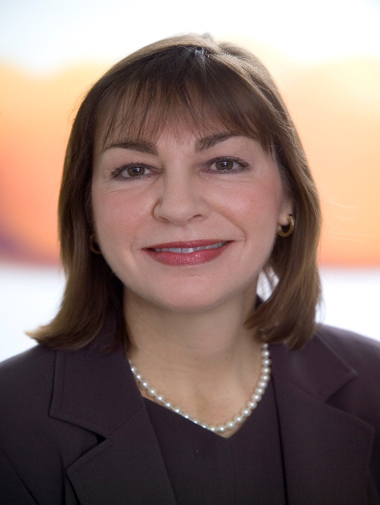
About Our Panel

Slide 4
Objectives
Summary overview of maintenance of certification
Strategic perspective on the nature and the maturity of a field (in regards to the maintenance of certification)
What qualifies for certification maintenance (credit types)
Regulatory compliance and changes
Using data to inform decision making (e.g. tie the requirements to reflect changes and trends)
Authorized providers business model (how to tie it to the accreditation requirements and specific industries)
Allocation of resources
New program vs well established organization
Accreditation requirements

Slide 5
Question #1
What do you want to achieve when recertifying a candidate? What is the purpose (e.g., protect the public from incompetent professionals)?

Slide 7
Question #2
Are the MDs Correct in removing MOC requirements? What if the certification industry removed such requirements in general?
Notes:
They claim they can use this time to see patients.

Slide 8
Question #3
Why do you think there is a movement to remove recertification requirements? Is this dangerous? And how would we know?
Notes:
They claim they can use this time to see patients.

Slide 9
Question #4
What do you think we can do to reverse this trend of removing recertification requirements with doctors and other professions requiring certifications? And more importantly, should we?
Notes:
They claim they can use this time to see patients. Who is impacted when we fail to measure ongoing competency

Slide 10
Question #5
Do you think recertification requirements work? How so? What does it mean to say that recertification requirements work? Against what outcomes?

Slide 11
Question #6
If you were to build a recertification program what would it look like (e.g., activities, assessments)? Please consider the following:
Using data to inform the design (e.g., requirements, period, what do you call it [e.g., PDUs, CEUs], SME involvement, localization/translation of materials)
Allocating resources (e.g., staff, vendors, technology, customer service, SME involvement)
Accreditation requirements
Ensuring certified individual is maintaining competency

Slide 12
Question #7
Should a person after a few years of being certified be at a higher level of competency? If so, how would you address that in in our industry?

Slide 13
Question #8
1. How do you ensure that the recertification requirements/activities are equivalent to each other, especially when multiple recertification paths exist?
2. How do you work with training providers and other providers to ensure the content and quality is aligned with the scope, content, and the level (e.g., minimal competence)?

Slide 14
Question #9
How does the rest of the world manage recertification? Is there a trend of reducing it outside the US? A trend increasingly using it outside the US?

Slide 15
Question #10
What is the future of recertifying individuals?
Will it improve the maintenance of competency?
Will it be more real-time?

Slide 16
Questions

