Slide 1
IMPROVING ORGANIZATIONAL INNOVATION
ONE TEAM AT A TIME

Slide 2
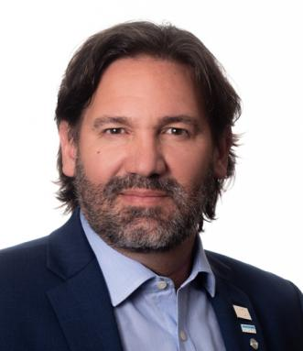
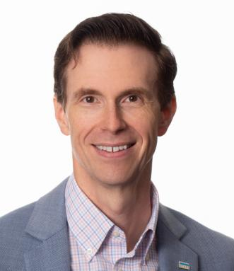
GUILLERMO ORTIZ DE ZARATE
Chief Innovation and Information Officer
National Council of Architectural Registration Boards
JARED ZURN, AIA, NCARB
Vice President, Examination
National Council of Architectural Registration Boards

Slide 3
what brought you to this session?

Slide 4
can you define innovation?

Slide 5
why focus on innovation?

Slide 6
future = uncertainty / disruption
Digitlabz.com
Mwrf.com
Barrons.com
https://readwrite.com/2017/01/11/augmented-reality-and-its-impact-on-real-estate-il4/

Slide 7
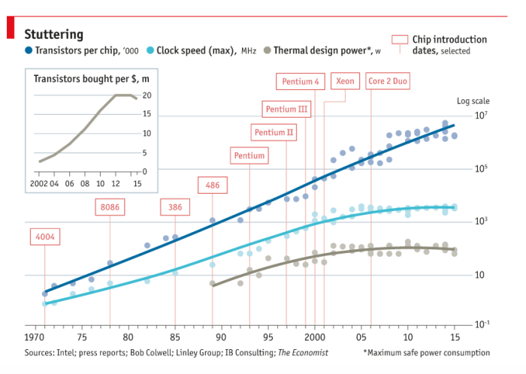
rate of change
Mitchell, Oliver. Preparing for the End of Moore’s Law. ALLEYWATCH. https://www.alleywatch.com/2017/03/preparing-end-moores-law/

Slide 8
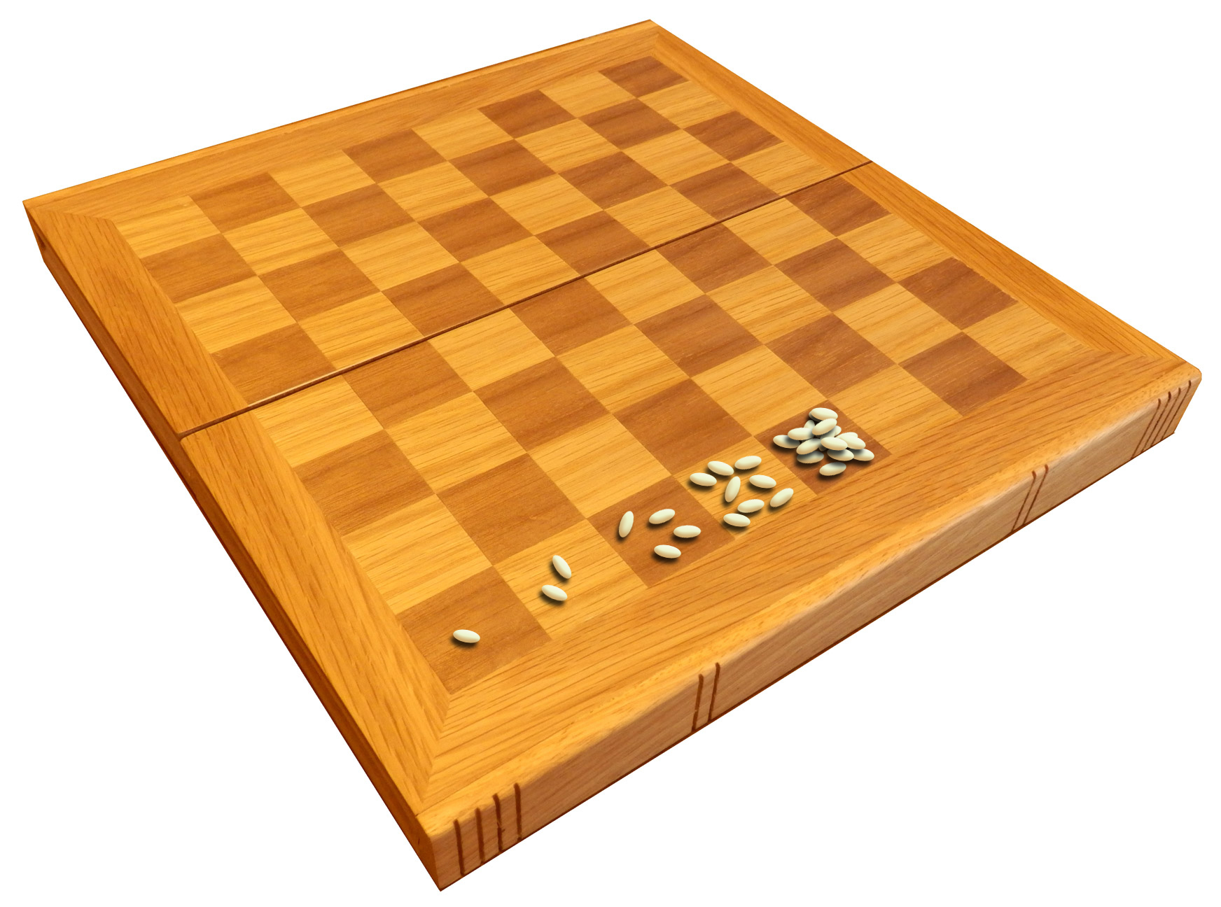
rate of change
King Shihram of India was an oppressive tyrant. One of his subjects, Sissa ibn Dahir, invented chess
McGeddon - Own work - This file was derived from Empty wooden chessboard.jpg: (public domain)

Slide 9
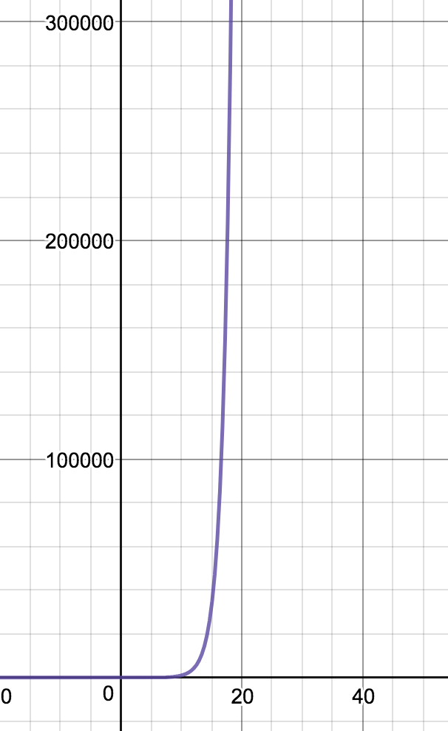
rate of change
2^{X}

Slide 10
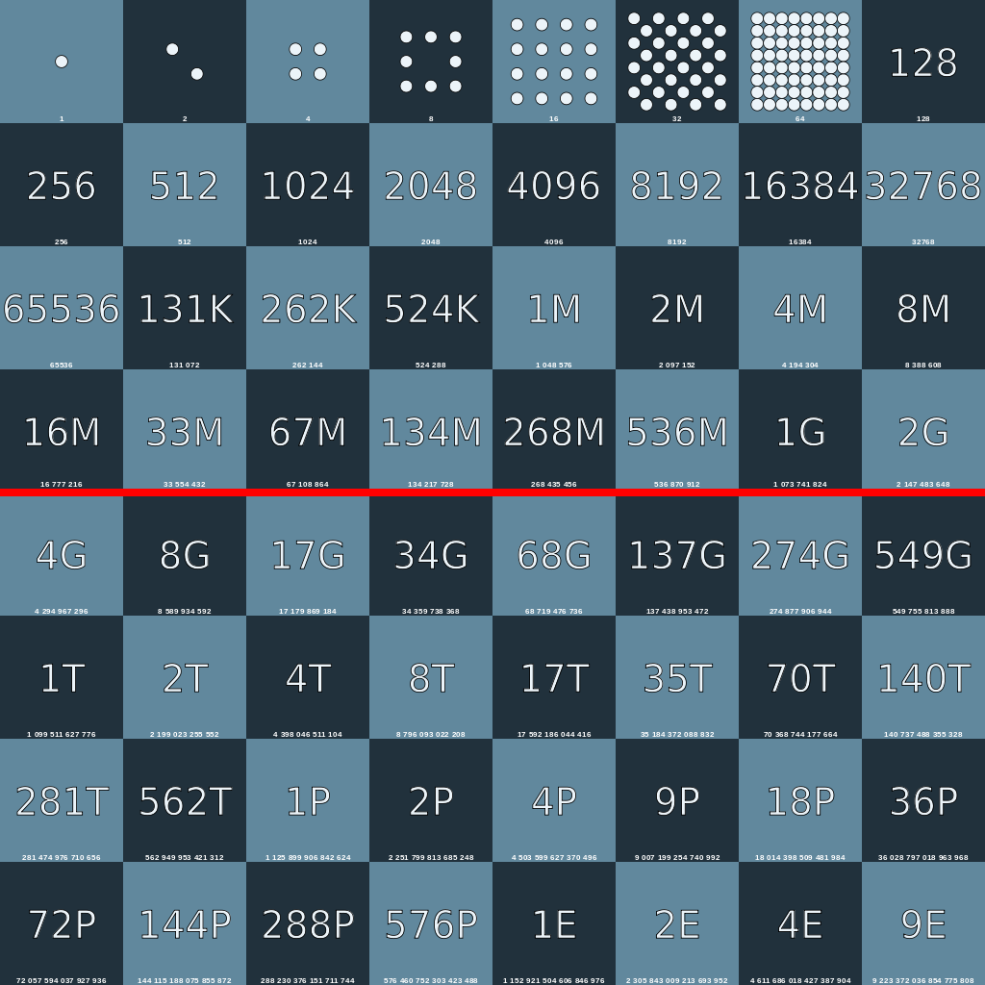
rate of change
2^{X}
An illustration of Ray Kurzweil's second half of the chessboard principle. The letters are abbreviations for the SI metric prefixes.

Slide 11
rate of change
9 quintillion
9 E
9,223,372,036,854,775,807
2⁶⁴
An illustration of Ray Kurzweil's second half of the chessboard principle. The letters are abbreviations for the SI metric prefixes.

Slide 12
the age of acceleration
rate of change
we are here
human adaptability
technological
innovation
personal computer
AI
time

Slide 13
dynamic stability

Slide 14
innovative culture

Slide 15
stretch goals
roots & wings
external
relationships
innovative culture
bust
hierarchy
systems
thinking
focus
https://www.mckinsey.com/business-functions/strategy-and-corporate-finance/our-insights/creating-an-innovation-culture
Notes:
Creating an innovation culture
By Dr. Waguih Ishak
https://www.mckinsey.com/business-functions/strategy-and-corporate-finance/our-insights/creating-an-innovation-culture

Slide 16
chicken or the egg
leadership / board of directors or the employees

Slide 17
leadership / board of directors
generative
strategic
operational

Slide 18
employees
generative
strategic
operational

Slide 19
leadership framework
Generative
Strategic
FY19
FY20
FY21
Operational
continuity of vision
Control the Conversation

Slide 20
employee framework
enterprise agile planning
Yearly Objectives
2 Month Release Plan
Team Sprints
visibility and insight

Slide 21
check for fit
roots & wings
stretch goals
bust
hierarchy
external
relationships
focus
systems
thinking

Slide 22
what is entrepreneurship?
Notes:
"entrepreneurial" describes a skill and mind-set characterized by innovation, creativity, calculated risk-taking, and an empowered staff.
Mark Miller is the Global CEO of Volaris Group and Trapeze Group

Slide 23
why focus on entrepreneurship?

Slide 24
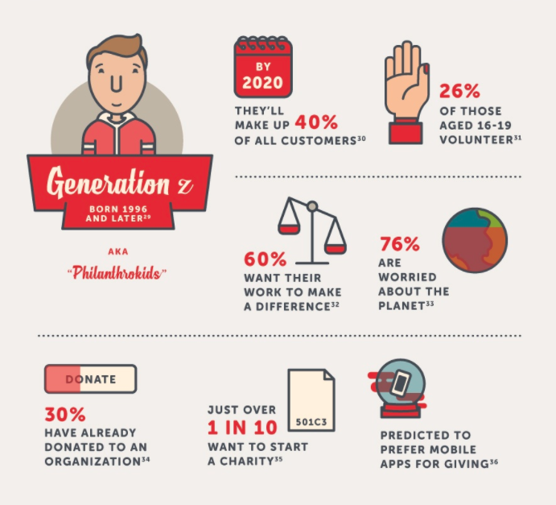
future = uncertainty / disruption
meetingsnet.com
Classy.org
medium.com/@fidelvti/blockchain-for-dummies
Notes:
According to a recent McKinley Advisors study, “The Health of Associations in the 21st Century,” associations rank in the bottom quarter behind for-profit organizations when it comes to members being likely to recommend the organization to friends or colleagues.

Slide 25
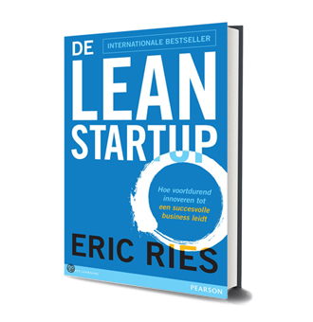
entrepreneurial approach

Slide 26
think big
start small
scale fast

Slide 27
find your riskiest assumption
build something that can validate it
run an experiment and measure
 repeat
BUILD
LEARN
MEASURE
Notes:
Tell the ARE Yelp story

Slide 28
beware of vanity metrics

Slide 29
vanity metrics
good metrics
Acquisition
Activation
Revenue
Retention
Referral
page views
visitors
avg. time on page
downloads

Slide 30
persevere
pivot
abandon

Slide 31
NCARB rate of change
Lean
Development
Enterprise
Agile
NCARB
VMS
Agile Planning

Slide 32
gortiz@ncarb.org Guillermo@lineupteams.com
JARED ZURN, AIA, NCARB
Jzurn@ncarb.org

