Slide 2
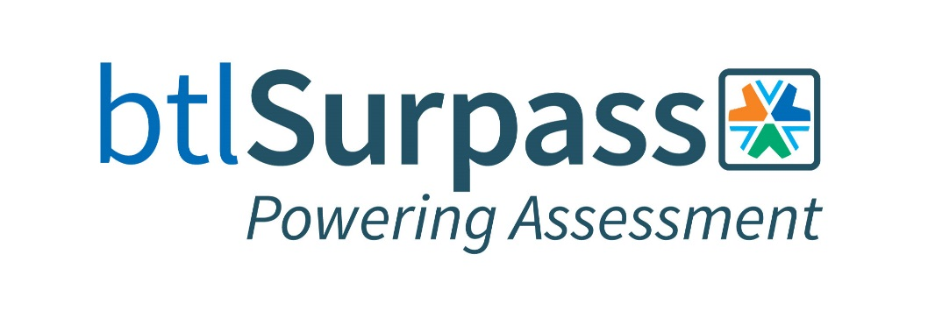
Thank you to our Full Sponsors!

Slide 3
Thank you to our Supporting Sponsors!

Slide 4
Thank you!
Today’s Sponsor

Slide 5
Proudly sponsors

Slide 6
Surpass Update
Adoption of Remote Proctoring to support delivery into physical test centers.
Increased use of Surpass Tasks to support Item Authoring.
Coming soon: Introduction of Standard Setting in Surpass – New functionality to help organizations manage their Standard Settings process.

Slide 7
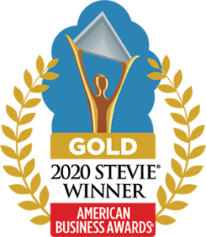
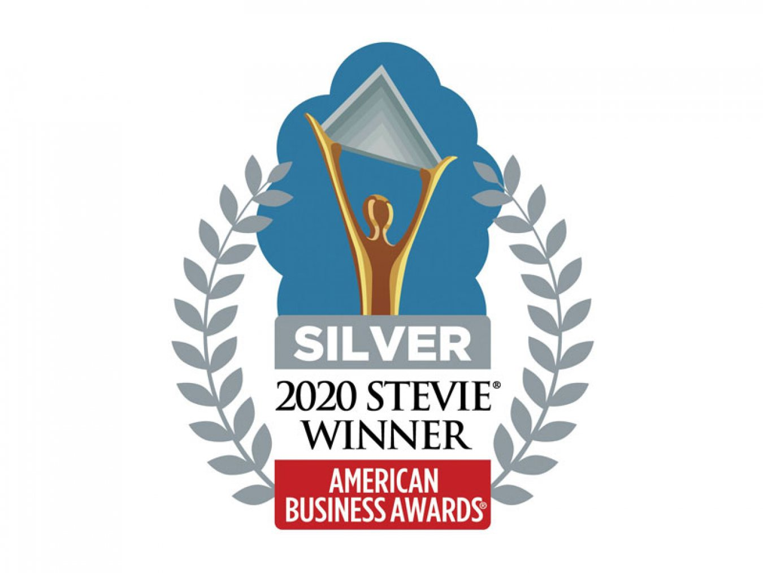
2020 Achievements/Awards
Winner of the Queen’s Award for Enterprise (most prestigious business award in UK)
Winner of four American Business Awards:
Gold for Best Student Assessment Solution
Gold for Most Innovative Tech Company of the Year
Silver for Fastest Growing Tech Company of the Year
Silver for Achievement in Growth
Silver for Product Management Team of the Year
Notes:
Queen’s Award for Enterprise is the most prestigious award for UK businesses and are designed to recognise and encourage outstanding achievements in the fields of: • innovation • international trade • sustainable development • promoting opportunity (through social mobility)

Slide 8
Join us online for on the 7th, 8th and 9th October 2020 9am – 12 noon EST.
For more details, visit: conference.surpass.com

Slide 9
Barry Porter
VP Account Management
Barry.porter@surpass.com
484 340 8189

Slide 10
Certification’s Opportunity to Create Value in a Chaotic Work World

Slide 11
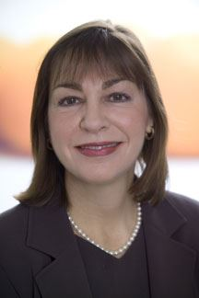
Today’s Moderator
Christine Niero , PhD.
Vice President, Professional Certification and Client Development
Professional Testing, Inc.

Slide 12
Today’s Speakers
Dr. Roy Swift Dennis Glenn, MFA
Executive Director President
WorkCred Dennis Glenn, LLC

Slide 13
Elevating the Visibility, Relevance, and Value of Certifications to Help Close the Pandemic Divide
Workcred Presentation to the Certification Network Group
October 7, 2020
Roy A. Swift, Ph.D., Executive Director, Workcred

Slide 14
Current State of the Workforce

Slide 15
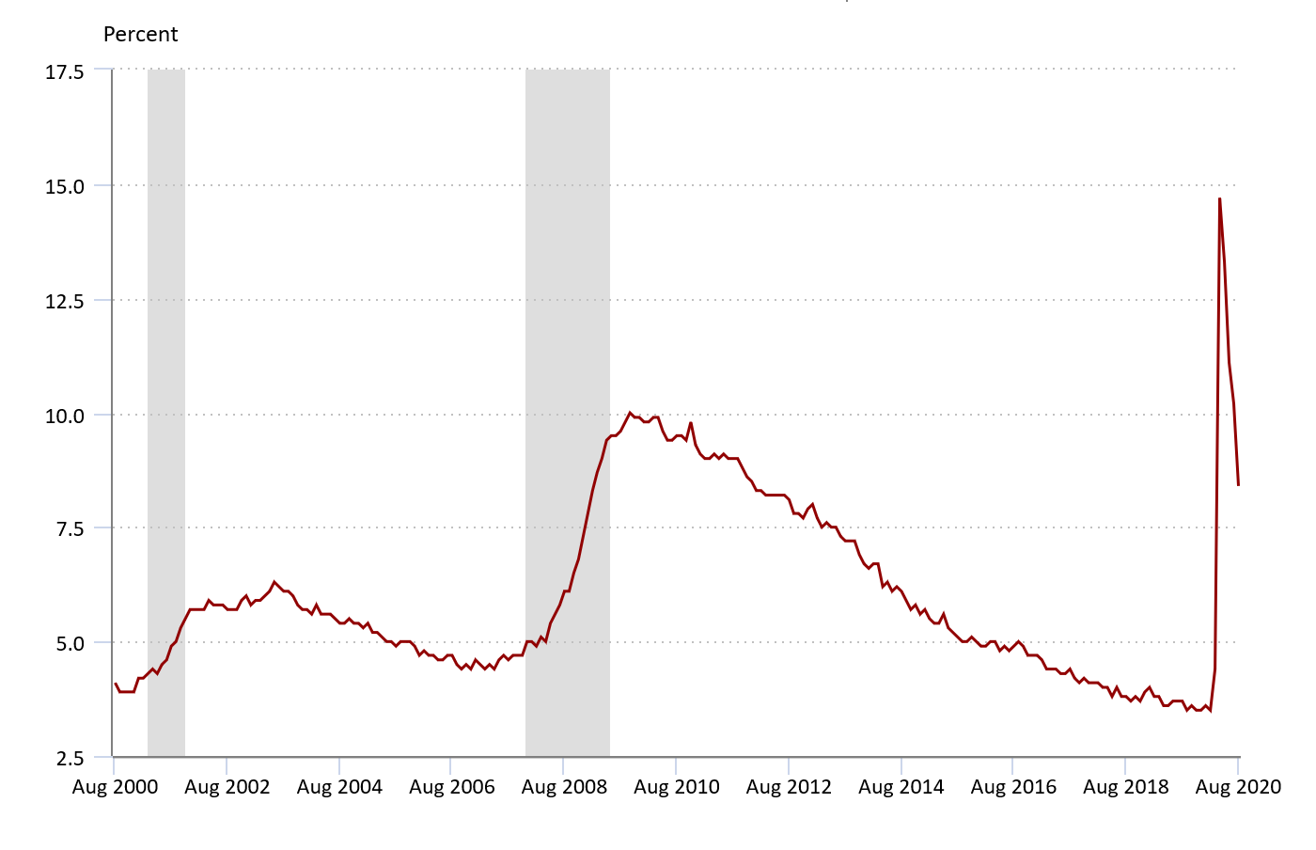
Civilian Unemployment Rate
Aug. 2020: 8.4%
Source: U.S. Bureau of Labor Statistics
Notes:
The shaded areas represent recessions.
Current unemployment rate is 8.4%.

Slide 16
More than 55 Million Americans Filed for Unemployment Benefits
Source: https://oui.doleta.gov/unemploy/claims.asp
Notes:
Source: https://oui.doleta.gov/unemploy/claims.asp

Slide 17
1/3
of individuals in the workforce believe they will need additional education and skills to find comparable employment if they lose their job
Source: Public Viewpoint: Covid-19 Work and Education Survey,” Strada Education Network, April 7, 2020, https://www.stradaeducation.org/publicviewpoint

Slide 18
35%
of adults are planning to change careers if they lose their jobs
Source: Public Viewpoint: Covid-19 Work and Education Survey,” Strada Education Network, April 7, 2020, https://www.stradaeducation.org/publicviewpoint

Slide 19
Some College, No Degree
36 million people hold some postsecondary education and training, but did not complete and are no longer enrolled
Source: National Student Clearinghouse: https://nscresearchcenter.org/some-college-no-degree-2019

Slide 20
Certifications in the Current State of the Workforce
The pandemic has created an economic and social divide that disproportionately affects workers in industries that may not bounce back to previous employment levels.
Certifications can assist workers in finding jobs.
There is an opportunity for certification bodies to help both individuals and employers.

Slide 21
Role of Certifications

Slide 22
The Certification Community Often Acts as a Planet Unto Itself

Slide 23
Credentialing Ecosystems
Badges
Certificates
Continuing Education
Certifications
Degrees
Micro-Credentials

Slide 24
Value of Certifications
Workers with certifications are more likely to see their job as a career [54%] than those without certification [37%]
Workers with certifications are more likely than those without certifications to say they are expected to be creative or innovative in their jobs [58% versus 43%]
Sources: Professional Certifications Offer Workers with No College Degree a Pathway to Good Jobs, https://www.luminafoundation.org/resource/professional-certifications-offer-workers-with-no-college-degree-a-pathway-to-good-jobs; and Professional Certifications Offer Workers with No College Degree a Pathway to Good Jobs, https://www.luminafoundation.org/resource/professional-certifications-offer-workers-with-no-college-degree-a-pathway-to-good-jobs

Slide 25
Adults Without a Degree Who Hold a Certificate or Certification
Have higher full-time employment rates than their peers with no credentials (85% versus 78%).
Have a median annual income of $45,000, compared to $30,000 for those without a credential.
Perceive their education paths as more valuable and are more likely to recommend them to others than are those without a credential.
Source: Certified Value, When do Adults without Degrees Benefit from Earning Certificates and Certifications?, https://www.stradaeducation.org/report/certified-value

Slide 26
What Workforce Issues Should the Certification Community be Paying Attention to?
Confusion about terminology
Equity
Fast pathways to employment
Unbundling of credentials
Regionally accepted credentials
Employability and soft skills
Upskilling
On-going and systemic feedback from employers
Notes:
Confusion about terminology used to describe various credentials (e.g., certification v. certificate).
Increased focus on equity.
Desire to identify the quickest way to get people into the labor market using quality credentials that lead to credential and career pathways and good jobs. Good jobs include those that provide livable wages and the opportunity for advancement. Certification can be a bridge to good jobs.
Unbundling credentials into skill bundles that can be packaged into micro-credentials.
Need for a credentialing system that has on-going and systematic feedback from employers to credential issuers.
Focus on regionally accepted credentials as opposed to national credentials.¹⁰
Higher education is retooling to better meet the needs of industry.
The economy and jobs are shifting and therefore we must address declining industries, the emergence of new industries and occupations.
Industry says that a shortfall of certifications is that employability/soft skills are not assessed, yet they are essential to every job. (I think I have a slide on this)

Slide 27
The Future Will Hold Increased Demand for Integrated Models of Learning
Degrees embedded with certifications
Work-based learning
Boot camps
Notes:
A Growing Need for Integrated Models of Learning
Integrating certifications and other non-degree credentials within baccalaureate programs can enhance the value of the degree by:Increasing students’ mobility across employers and industries Improving their employment outcomes
Sending stronger signals to employers about what a student can do

Slide 28
WORKCRED’s research projects

Slide 29
With the emergence of many different types of credentials, including badges, certificates, and micro-credentials, there is a growing need to understand the value or ROI of certifications.
Workcred is engaging more than 30 certification bodies in discussions around the value of sharing their data so the information about their credentials can be better understood by policymakers, funders of research, state officials, consumers of certifications, and education and training providers.
WORKCRED Voluntary Data Sharing Network

Slide 30
Minimum Data Elements Needed for Data Sharing

Slide 31
Additional Data to Support Data Matching

Slide 32
Additional Data to Support Data Matching Cont’d

Slide 33
Optional Data Elements for Additional Insights

Slide 34
Aligning and Embedding Certifications in Bachelor’s Degrees
OPPORTUNITY
To convene certification bodies and universities to explore how students can earn both degrees and certifications as part of their four-year degree program
PROBLEM
Insufficient opportunities for students to earn certifications with labor market value and build those credentials toward a degree
Project Partners
FUNDED By

Slide 35
Key Themes from the Project
Certification bodies and universities gained knowledge and better understand each other;
Fostered an emerging community of practice between universities and certification bodies;
Developed a framework that identifies certification-degree pathway examples, challenges, and opportunities associated with building these pathways;
Identified value propositions for students, certification bodies, universities, employers, accreditors, and society as a whole; and
Discovered examples of partnerships between certification bodies and universities.

Slide 36
MANUFACTURING RESEARCH STUDY
In follow up to the first report, Workcred and partners are now conducting a research study to better quantify the return on investment of credentials in manufacturing.
Will result in better understanding of how credentials can serve as an important resource in identifying skilled workers.

Slide 37
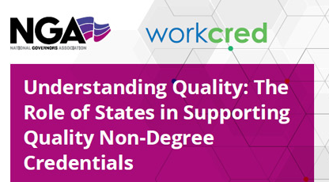
WORKCRED and national Governors Association Report on Quality
Recommendations
Develop standardized definitions of the different types of non-degree credentials.
Understand and access the quality of credentials.
Ensure that non-degree credentials are accepted as college credit and embedded into degree programs.

Slide 38
The future is now

Slide 39
A Call to Action!
Join the Workcred projects
Work with universities
Reach out to industry beyond the job analysis
Establish relationships with state officials
Apply to be on states’ eligible training provider lists
Notes:
Establish relationships with state officials such as those in the governor’s office, department of education, and economic development

Slide 40
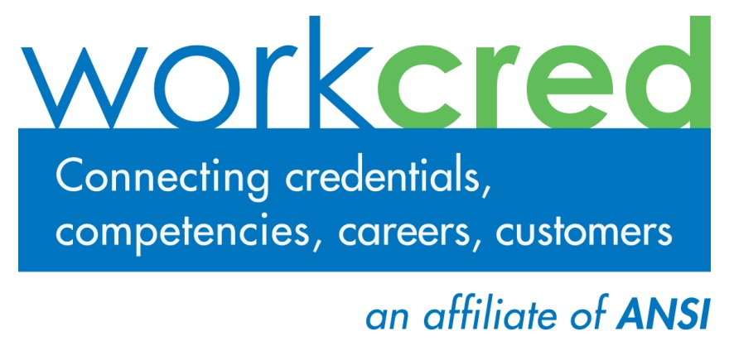
for more information
Workcred Headquarters
1899 L Street, NW
Washington, DC 20036
www.workcred.org
Roy Swift
Executive Director
Workcred
rswift@workcred.org
202.331.3617
www.workcred.org

Slide 41
Micro-Learning,
the Next Great Innovation in Certification and Assessment
Dennis Glenn, MFA
MicroLearning
I have no affiliation with any of the software programs that will be used in this presentation.

Slide 42
Gaming has become one of the biggest global entertainment industries, with 2.7 billion people projected to play a game this year, according to the gaming market researcher Newzoo. Growth has accelerated during the pandemic, and gamers worldwide are expected to spend nearly $160 billion this year. https://www.nytimes.com/2020/09/15/technology/xbox-series-x-playstation-5.html

Slide 43
https://www.slideshare.net/jbersin/the-disruptive-nature-of-digital-learning-ten-things-weve-learned/22-Source_Meet_the_Modern_Learner

Slide 44
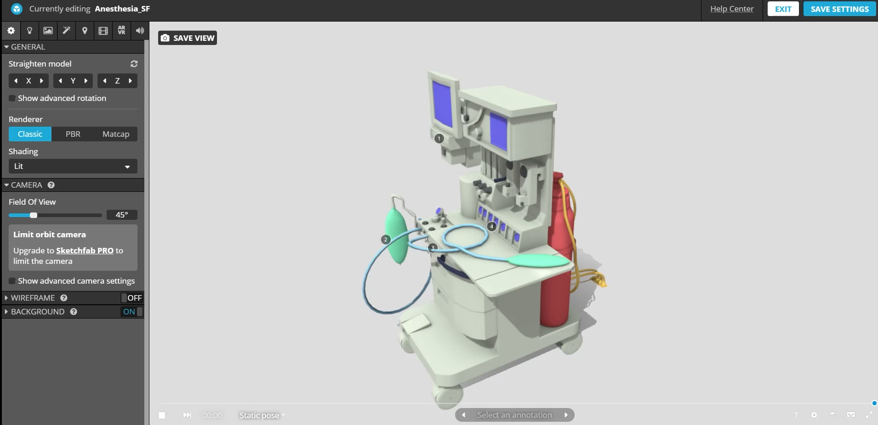
https://sketchfab.com/3d-models/anesthesia-sf-7ae35c7d5b9b4872af390969292f7914

Slide 45
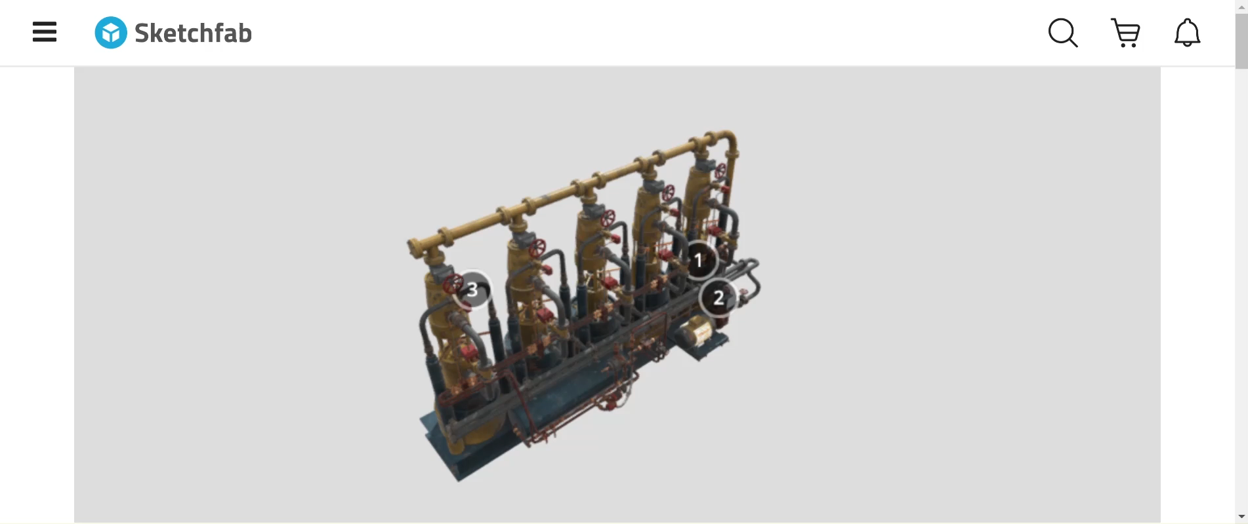
https://skfb.ly/6V7R7

Slide 46
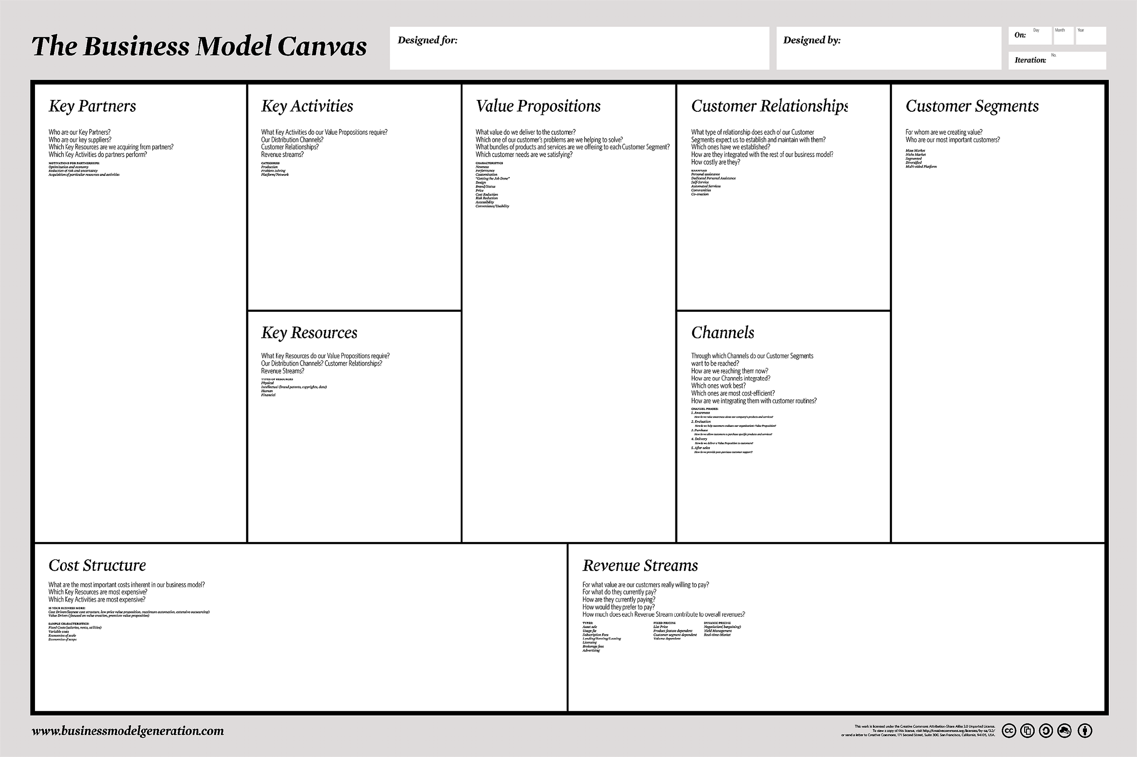
https://www.strategyzer.com/canvas/business-model-canvas

Slide 47
With!
Why!
Who!
1111
Who
What!

Slide 48
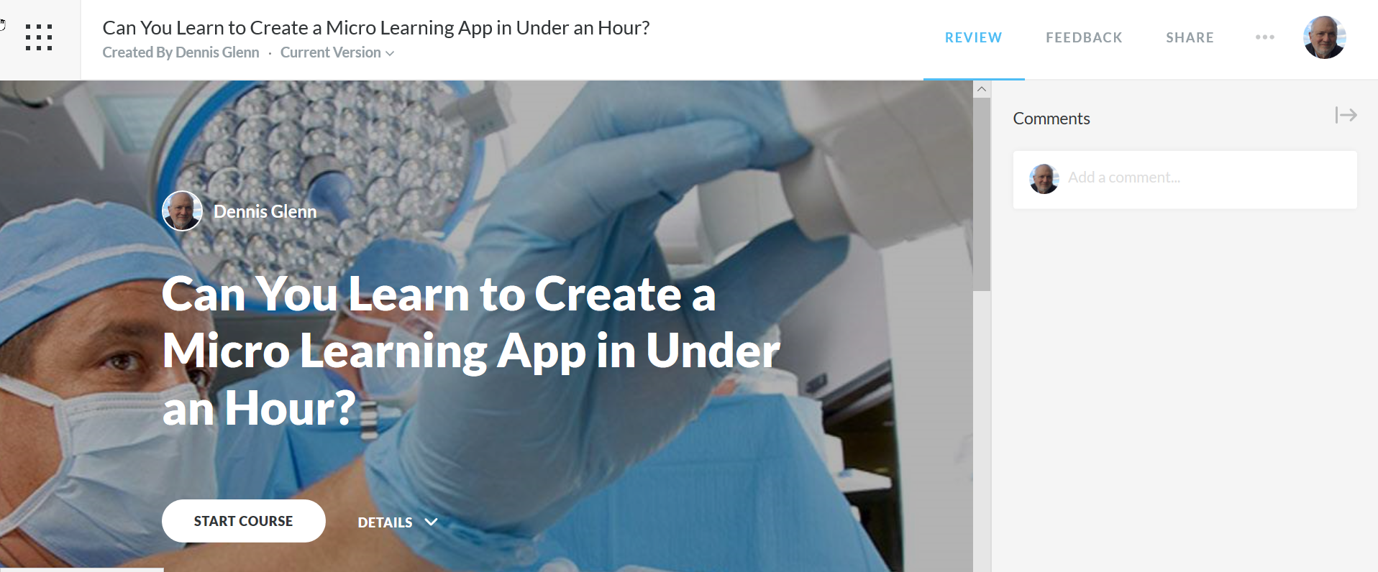
https://rise.articulate.com/share/TzMMAFhOk23qxncwiZyI8iwHKkbfYGy4

Slide 49
Workcred defines a certificate as a credential that is “awarded upon completion of an education or training program.” But even that definition is imperfect since there are many types of certificates–certificates of completion, certificates of apprenticeship, assessment-based certificates, and certificates of participation.
The challenge is that only a few types of certificates actually measure learning outcomes. Certifications have three distinct elements: a standardized exam, a recertification requirement and the ability of the awarding body to revoke the certification for proven incompetence or a violation of a code of ethics.
We need a better understanding of online learning in all its forms–traditional online courses and programs, online micro-credentials, digital learning at work, etc.
https://evolllution.com/programming/credentials/embedding-certifications-into-bachelors-degrees-could-improve-transitions-into-the-labor-market/

Slide 50
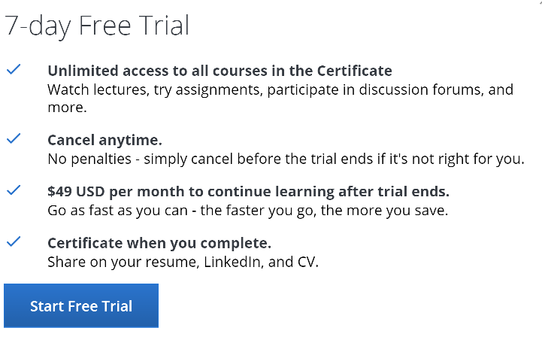
Google Is About to Launch 6-Month, $300-ish ‘Career Certificates’ that Require No Previous Education
Google has already launched two Career Certificate courses for entry-level positions: Google IT Support and Google IT Automation with Python. About 85% of the 637,047 enrolled students left raving 5-star reviews.
Based on this success, Google is planning to launch three more courses: one for data analysts, one for product managers, and one for UX designers. You can choose to get notified when these courses come out on their website.
Are these certificates a safe pathway into an entry-level position at Google? Based on their unambiguous language, it would seem so.
Kent Walker, Google’s senior vice president of global affairs, has posted the following information in a Tweet:
“In our own hiring, we will now treat these new career certificates as the equivalent of a four-year degree for related roles.”
Google has effectively replaced four-year college degrees with a lean 3-to-6 month program that only takes about 5 hours a week to complete.
To Open this website, Left Click while viewing this image.
https://www.coursera.org/professional-certificates/google-it-support?utm_medium=email&utm_source=marketing&utm_campaign=lOjOENLaEeqlgefw1tB51Q

Slide 51
While formal degrees remain valuable, there is a large market of lifelong learners seeking specialized credentials or targeted skills for personal and professional development. Much like “customers,” the learner of today may benefit from targeted micro-learning options allowing them greater customization of content to fit their personal and professional interests.
As an adult learner, you often want to take what you’re learning and apply it right away on the job or in your own life.
In today’s fast-paced world we all need to constantly upskill, to get a better job or to change careers, or perhaps to earn CEUs to maintain professional certification/accreditation.
Technology must be easy to assemble and use. Competence is Achieved through Participation in Authentic Situations.
https://evolllution.com/programming/program_planning/unbundling-credit-programming-into-non-credit-offerings/

Slide 52
Disruptive innovation describes a process by which a product or service powered by a technology enabler initially takes root in simple applications at the low end of a market — typically by being less expensive and more accessible — and then relentlessly moves upmarket, eventually displacing established competitors.
Disruptive innovations are not breakthrough innovations or “ambitious upstarts” that dramatically alter how business is done but, rather, consist of products and services that are simple, accessible, and affordable.
Customers don’t buy products or services; they pull them into their lives to make progress. We call this progress the “job” they are trying to get done, and in our metaphor we say that customers “hire” products or services to do these jobs.
https://sloanreview.mit.edu/article/an-interview-with-clayton-m-christensen/?utm_source=newsletter&utm_medium=email&utm_content=Read%20the%20interview%20now%20%C2%BB&utm_campaign=Enews%20GEN%202/4/2020

Slide 53
This program enables you to demonstrate your proficiency in the latest IBM technology and solutions. We want to help establish that you have the capability to perform role-related tasks and activities at a specified level of competence. Your participation is beneficial if you wish to validate your skills, as well as for companies that wish to ensure certain performance levels for their employees.
IBM Professional Certifications are associated with an individual, not a company or organization. The target audience for certification includes employees of Business Partner Firms, Customers, IBM internal employees, and Independent Consultants who sell, support, or service IBM products.
Certifications are designed to validate skills needed in a specific job-role. Mastery Skills help to assure an individual has achieved a foundation of knowledge and understanding of a subject matter. Mastery Skills supplement Certifications as a method used by IBM to evaluate knowledge of IBM Sales and Technical Professionals. https://www.ibm.com/certify/informationcenter.html

Slide 54
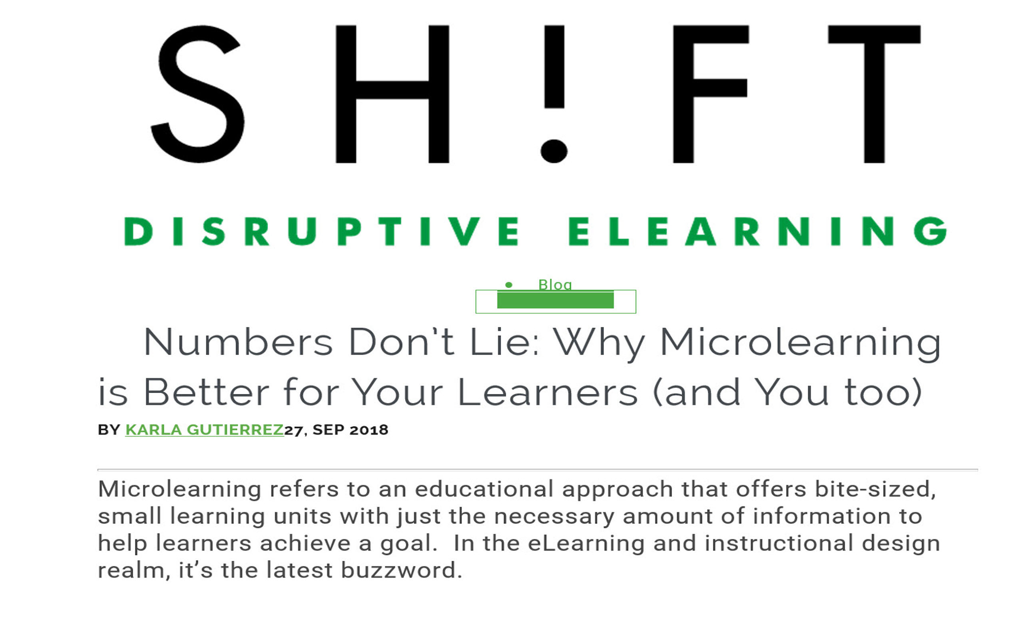
https://www.shiftelearning.com/blog/numbers-dont-lie-why-bite-sized-learning-is-better-for-your-learners-and-you-too

Slide 55
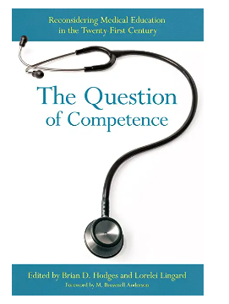
A credential is a form of currency, and in order to be a currency it needs to have relevance to both the buyer and the seller.
Jonathan Finkelstein, Founder and Chief Executive Officer of Credly
https://evolllution.com/programming/credentials/the-evolving-transactional-nature-of-credentialing-the-future-of-alternative-credentials/
Cornerstone.com

Slide 56
https://docs.google.com/presentation/d/1ppAKToiYz0Sc-A6OIxEQUHcMoZEvpp8-VQM3zOzGB8I/edit?usp=sharing

Slide 57
https://www.christenseninstitute.org/publications/student-centered-educator-competencies/

Slide 58
https://www.gartner.com/en/documents/3981627/top-10-business-trends-impacting-higher-education-in-202

Slide 59
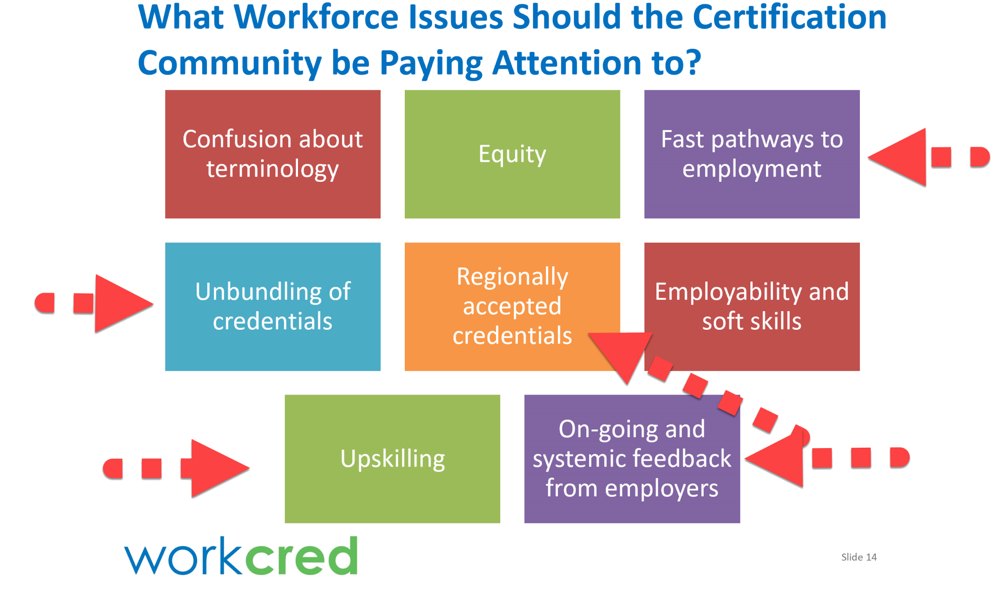

Slide 60
Knowledge Transfer: You Can't Learn Surgery By Watching, Learning to perform a job by watching others and copying their actions is not a great technique for corporate knowledge transfer.
Christopher G. Myers
https://journals.aom.org/doi/abs/10.5465/amr.2016.0202
A 1972 study by Fergus I. M. Craik and Robert S. Lockhart in The Journal of Verbal Learning and Verbal Behavior, which shows that memory of material is enhanced by “deep” cognitive tasks. In an educational context, such tasks would include working with material, applying it, arguing about it (rote memorization is insufficient).
https://www.theatlantic.com/magazine/archive/2014/09/the-future-of-college/37507
The model, which has become more prominent in programs that serve non-traditional learners, aims to measure the skills students have mastered, rather than how long they’ve spent trying to learn them. Competency-based learning should also make course credits more transferable because colleges and universities will have a better idea of what a student knows.
https://universitybusiness.com/competency-based-learning-college-online-learning-classes-courses-coronavirus/?utm_source=Ed%20Digest&utm_medium=email&utm_campaign=4%2F24%2F20
According to a report by Software Advice, The LMS Features that Drive Employee Engagement IndustryView, more the 50% of the 385 employees who took part in a survey indicated that they would use their company’s learning tools more if the courses are shorter. According to them, longer courses are not only more challenging to digest and retain but taking them also gets in the way of their daily work.
https://www.shiftelearning.com/blog/numbers-dont-lie-why-bite-sized-learning-is-better-for-your-learners-and-you-too

Slide 61
Stackable Credentials: Defining Their Value
Joann Kozyrev | Vice President of Design and Development, Western Governors University
Stackable credentials have the capacity to transform student pathways to degrees and employability—fundamentally shaking up the core of traditional higher education—but only if their quality aligns with their promise.
The benefit of certificates that stack into degrees is that shorter programs may appeal to students who need or want to work while learning. They also create clear pathways with incremental goals, allow for more agility in curriculum design and delivery, and support a more open-loop lifelong approach to education.
Do Stackable Credentials Offer Students Value?
Do Stackable Credentials Offer Employers Value?
Do Stackable Credentials Offer Society Value?
Do Stackable Credentials Offer Educational Institutions Value?
https://evolllution.com/programming/credentials/stackable-credentials-defining-their-value/
https://evolllution.com/opinions/remember-building-stackable-credentials/
https://sloanreview.mit.edu/article/the-challenge-of-scaling-soft-skills/
https://evolllution.com/programming/credentials/microcredentials-closing-the-skills-gap-and-adding-value-to-passion/

Slide 62
Dennis Glenn, MFA
Dennis Glenn, is President and Chief Learning Officer and an adjunct professor at DePaul University Graduate School for Continuing and Professional Studies. His instructional design and eLearning experience was honed when he joined Northwestern University as manager of the advanced media production studio. In 2001Glenn was promoted to assistant dean for distributed education at the School of Communication where he was the Director of the Distributed Learning Center. Dennis has designed interactive virtual patients for the medical industry that assess the cognitive decision-making abilities of surgeons, doctors, and nurses. He has created learning and assessment simulations for Pearson Learning, Baxter, Abbott Labs, American Association of Nurse Anesthetists. He has taught at Northwestern, Columbia College Chicago, Lake Forest Graduate School of Management, and DePaul’s Graduate School for Continuing and Professional Studies, where he teaches in two domains: engaging social media, and mastery learning using serious games.
dennis@dennisglenn.com

Slide 63
Questions

Slide 65
Next CNG Meeting Details
When: TBD
Where: Virtual
Topic: We welcome your suggestions! We will also review past surveys and calls for topics.

Slide 66
Thank you for attending!

