Slide 1
Random Success Game
Goal: Meet credentialers interested in games as assessment and give out all your stars
Strategy: Mingle and give out stars as follows – collect names of people to whom you give out stars
Time: 5 minutes
Meet someone who has… | Give out
Developed at least one learning game | 4
Attended a class that used a learning game | 3
Wants to learn more about using learning games | 2
Wants to learn more about using games as performance-based assessments | 1
Use reverse side to collect names of people you meet and your own stars
Notes:
Display this information and handout sheet with same info along with a set of stars. Group Game: Random Success” (Before welcome and official start of session).
o This is an introductory warm-up game to get participants talking to each other and the facilitator; it also helps to highlight the game mechanics – randomness and control 3 minutes
Welcome and introduction
Debrief game
Presentation: The relationship between randomness, control, and fun. Basic theory and resources. Plus some stories from my own experiences
Then we’ll take a few minutes to collect the wisdom of this community’s experience and debrief that.
At the end of this session, you will be able to:
* Evaluate learning games for randomness, control, and fun
* Use randomness and control more effectively in the design of serious learning games

Slide 2

Find a seat please
Thanks for playing the Random Success Game

Slide 3
Contextual Assessment: Games as evidence of competency
Sharon L. Gander, M.Ed, CPT, CACP. CIDD
Judith Hale, Ph.D., CPT, CACP, CIDD,
and ibstpi Fellow,
Notes:
Contextual Assessment: Games as evidence of competency
Games place learners in contextual situations that require analysis and action to create control over random game factors. Join in a large group game and discussion of game mechanics that create randomness or control. Learn from multiple case stories showing how games have been used to assess. Then, take the conversation deeper to consider how and when a game might be a performance-based assessment. Discuss the challenges and limitations of assessing game play as comparable evidence of competency.
Join the discussion of the growing demand for games as assessment methods and as alternatives to traditional multiple-choice exams. Come discover the emerging world of assessments where games, gamification, simulations, augmented reality (A/R), virtual reality (V/R), and certifications are creating new assessment techniques.
What will you learn?
At the end of this session, you will be able to
Evaluate learning games for randomness, control, and fun
Assess the potential for a game, augmented reality, or virtual reality to be used as an assessment technique
Explain to key decision-makers the strengths and limitations of using games, A/R, V/R for evidence-based assessments

Slide 4

Sharon Gander, M.Ed., CPT, CACP, CIDD
Director of ID Certification, Hale Associates’ Center
Learning Architect
Certification Specialist
Performance Improvement Specialist
Item writer
Author & Blogger
Serious Learning Game design & development
Connecting learning to workforce development
through targeted learning solutions using emerging and traditional learning technologies, certifications, microcredentials, and badges in order to show performance improvement.

Slide 5

Judy Hale, Ph.D., CPT, CACP, CIDD
Hale Associates, Credential Consultants
CEO, The Institute for Performance Improvement (www.tifpi.org)
Certification Specialist
Performance Improvement Specialist
Award winning author
Guiding and advising workforce development though credentialing; working around the world for professional development for emerging fields, trades, and high-tech providers.

Slide 6

Dennis Glenn, MFA
CEO of Dennis Glen, LLC
Instructor of Game Design at DePaul University
Professional photographer and film director
His company creates 3D interactive virtual patients for the medical industry that assess the cognitive decision-making abilities of surgeons, doctors and nurses. Dennis has taught at numerous universities including Northwestern, Columbia College, Lake Forest Graduate School of Management and is currently teaching as DePaul University Graduate School for New Learning.
dennis@dennisglenn.com
https://dennisglennllc.com

Slide 7
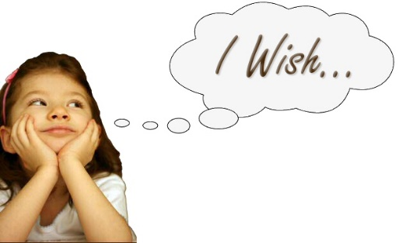
Today’s Goal
At the end of this session, you will be able to:
Evaluate learning and assessment games for randomness, control, and fun
Assess the potential for a game, simulation, augmented reality (A/R), or virtual reality (V/R) to be used as an assessment technique
Explain to key decision-makers the strengths and limitations of using games, A/R, V/R for evidence-based assessments
Begin building a community of practice for serious learning game designers.

Slide 8

Getting on the Same Page
Debrief the Game
Notes:
Who used up ALL their stars before the game ended? Technically, you are all the winners.
Who received more than 12 stars?
Of those of you who received more than 12 stars, who was able to also give away all their stars?
For those of you who received very few or no stars, what did you gain by participating?
Everyone…
What strategies did you try or did you observe others trying in order to find ‘success’? Was your own success more important or was it important that others found success?
What did you try that helped to create control in an environment focused on random choices?
Why did you avoid or turn down some strategies (yelling your status or sharing that you knew someone with a prime status)?

Slide 9

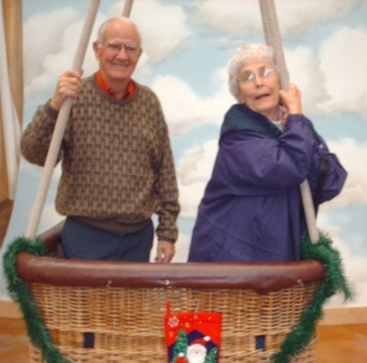
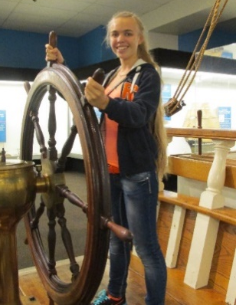
Where does “fun” come from?
Notes:
The relationship between randomness, control, and fun. Basic theory and resources

Slide 10
How do assessment experts use randomness and control in their work?
Randomness
When is randomness used in knowledge assessments
Order of blueprint sections presented
Order of items within a section
Order responses
Why is randomness important to assessment?
Helps prevent cheating
Helps provide the sense of realism
Creates greater fidelity in match to real world environment
Control
When is control used in knowledge assessments
Ensure equivalent experience between candidates
Ensure equivalency forms
Why is control important to assessment?
Supports validation across a wide spectrum of uses
Highlights “out of alignment” items
Notes:
Judy

Slide 11
What is a Game
Attested as early as 2600 BC, games are a universal part of human experience and present in all cultures.
A game is a structured form of play, usually undertaken for enjoyment and sometimes used as an educational tool.
Games are distinct from work, which is usually carried out for remuneration, and from art, which is more often an expression of aesthetic or ideological elements.
Key components of games are goals, rules, challenge, and interaction. Games generally involve mental or physical stimulation, and often both. Many games help develop practical skills, serve as a form of exercise, or otherwise perform an educational, simulational, or psychological role.
Serious games are educational experiences specifically designed to deliver formative or summative assessments, based on pre-determined learning objectives.
Wikipedia,
June 26,2017
Dennis Glenn 2018
Notes:
There’s our key… performs an educational, simulational, or psychological role. Games as tests provide a simulation of an environment that is wrapped in scoring methodology which provides the psychological assessment of decisions and actions.

Slide 12
Game Design & Luck
Distilled down to its essence, game design is about creating opportunities for players to make meaningful decisions that
affect the outcome of the game.
Game design is a field you must apply to learn. Truly, there is
no substitute for making games. In that process, you learn more than you would merely reading about making games.
Games that include an element of luck (randomness) are approachable and winnable by a wider audience because they:
  Delay solvability
  Create grounds for competition
  Increase variety, order, and difficulty of decisions to make
  Create dramatic moments
  Enhance decision-making
Challenges for Game Designers, Brahwaite & Schreiber, Course Technology, Boston, MA, 2009

Slide 13
Art of Game Design: Lenses
A few key lenses
  #1 - The Essential Experience (the player’s experience)
  #2 – Surprise
  #3 - Fun
  #4 - Curiosity
  #6 - Problem Solving
  #29 - Chance
  #66 – The Obstacle
  #72 – Indirect Control
  #97 – Transformation
    Games create experiences and experiences change people.
The Art of Game Design: A Book of Lenses,
Schell, CRC Press, Boca Raton, FL, 2008
Notes:
Sharon: Let’s consider what some of these lenses might offer us as people who assess others’ skills and knowledge.
Essential experience – tells us to pay attention of anything that detracts of the goal. Test designers work hard to ensure that their blueprint matches standards and that each test form provides the high quality items in each section. When we move into assessing real world actions, we work with administrators, proctors, and judges to ensure that they delivery the test experience fairly to all participants. We ARE concerned with the Essential Experience.

Slide 14
Stories of Real Games
Notes:
Sharon

Slide 15
Content & Control
PEAs – process, entities, and attributes
Process provides the game with a natural action path and goal (Level 2 of 3D-ID© graphic)
Entities (Levels 3 & 4) provide the game developer with:
  Actors
  Decisions for players to make
  Tools to be acted upon during play
Attributes (Levels 5 & 6) provide variables
or conditions that change the player’s
decisions and/or the outcome based on
play
PEAs provide content structure to determine the essential decisions and actions a player must learn and demonstrate – this creates a map for where to apply control.
Notes:
This classroom-based board game 3D-ID© ,was created for Cerner Corporation in 2001. A group of instructional designers and learning support staff were given a stack of cards. Each person was dealt a hand. In turn, each could place one of their cards on the “right” spot on the game board or draw a card. Once a card was placed, the rest of players could either challenge or accept the placement, If accepted, the player received points. If not and if the challenger could prove that is was an incorrect placement, the card’s player had to take back their card. The first person to place all of his or her cards after the entire deck had been drawn down, was declared the winner. This was a classroom game with a larger board – only the process half of the board is shown here. The other half including key terms, theories, and theorists names. Multiple game teams might be playing at the same time. The goal was to be the first team done with all the cards placed correctly. Various other rules of play increased collaboration after an hour and half of play.

Slide 16
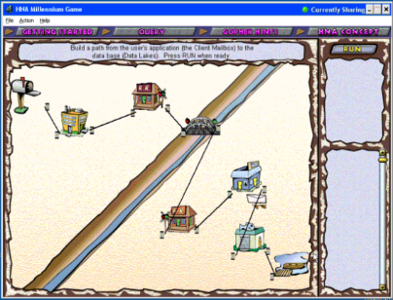
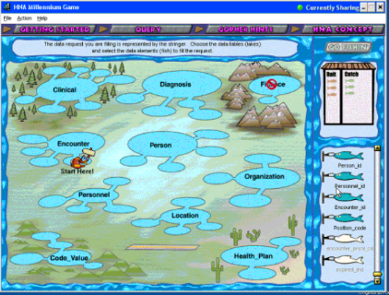


DataQuest: The HNAM Millennium Data Architecture Game©
HNAM Conversation
HNAM Data Request
In the conversation, each piece could be dragged and dropped anywhere on the board and could be connected to any other piece in any order. The assessment was the ability to get to the right answer (shown here) is the that gets to the database.
At the database (lakes), the airplane could fly to any lake (data table) in any order and any fish (data field) could be clicked, even though only one set of data matched the requested goal once the (assessed goal) was met more levels were available
Right clicking on any game piece or lake provided attribute-type information
Too hard to get started -- too much randomness required at the beginning; we added tutorials, helps, summary videos, FAQs as “controls” that learners could self-select
Notes:
This one is a computer game for both learning and knowledge assessment. The (continually assessed) goal is to move a message from the client (you) to the database, gather the client’s data, and accurately return it. We anthropomorphized the key functionalities that learners needed to understand well enough to explain to a non-technical consumer of our software.
In the conversation, when an incorrect pathway is built, the game stops and gives feedback intended to help the player rethink the solution. The assessment in formative and frequent and relatively non-punitive. When it is correct, the reward is forward movement with just a hint of silliness supplemented by video explanations and supportive documents and information.
One interest factor here was that this was built in 2001. There was no peer reviewed literature on the value of learning games in business settings. Our CLO needed supporting evidence that participants did in fact learn from the game. So, my first paper ever was to plan, and execute a study of a cross-section of learner/users/players to determine whether any learned anything at all and particularly whether the non-technical sales and consulting audience for who it was designed learned anything. And by “learned” we mean that they needed to produce evidence of how they would respond to common questions from our software clients. You can read all about the study and its results in the online article, Does Learning Occur through Gaming? eJist, 2001 (You can google it – Gander Does Learning Occur through Gaming?).
So, many forms of assessments here – formative assessments of learning, summative assessments of “correct response’, and an assessment of what learners acquired.

Slide 17
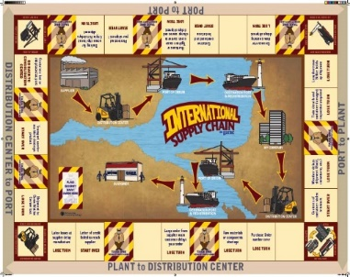
International Logistics Game ©
A live-classroom, board game played with dice and
rules similar to Monopoly; however each trip around
the outer board created (process) movement forward
on the inner board.
Goal was to move supplies from vendor (upper left of inner board)
to corporate (mid-point right of inner board) and from corporate to seller (lower left of inner board).
Player’s challenge was to “overcome” the logistics issues found around the board in the card deck.
Key non-play challenge: Where to place the game within a workshop taught by subject expert presenter.
  Presenter wanted to lecture first, then play in order to consolidate learning
  Presenter did not trust learners to come with enough skills to “get” key points in the game
  Presenter did not trust the randomness of game to give learners experience with majority of skills in the game
  Presenter needed to control the learning
During pilot, the learners recommended putting Round 1 of the game first, followed by lecture and discussion, followed by Round 2.
Notes:
Not used for assessment purposes

Slide 18
It’s All About the Assessment
One complex elearning project with 7 different sub modules offered the opportunity to “upgrade” the learner assessment at the end of the course from a multiple choice exam to a trivia quiz show style game-based exam. We had fun setting up a Jeopardy style game with 7 different “categories” and 5 questions per category. Pass = 100% (with as many retakes as you needed)
Military game placed the player in a submarine being approached by a potentially “unfriendly boogie.” The Player’s job was to defuse the situation by setting up the ballistic trajectory between the good guy and the bad guy before the “boogie” got off its first salvo. Players had to arm the torpedoes with the right longitude/latitude/depth information for a hit by:
  Identifying their current location on a world map and enter those coordinates
  Identifying the “boogie’s” location on a world map and enter those
    Identifying the type of “boogie” (size, speed, country of origin)
  Entering defining elements of the torpedo (length, weight, class) and the boogies depth
  Only then could they determine that is was friendly and hold fire or firing if it wasn’t

Slide 19

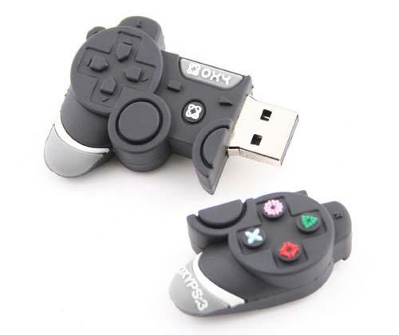
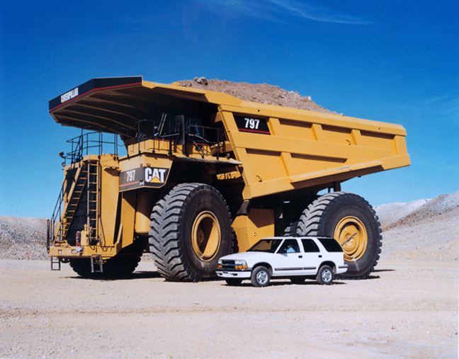
Augment Reality (A/R) & Virtual Reality (V/R)
The V/R zero-gravity chemistry lab
  Using a game controller
    Select and mix volatile chemicals
    Drop breakables and clean up deadly acids
    Invent new compounds with specific chemical characteristics
The A/R Monster Truck Design
  Redesign motor parts in a truck
  Check whether new design works
  Audit a service event

Slide 20
Simulations
Healthcare examples
  Onsite labs that simulate specific situations
    Child birth
    Surgery
    Code Blue
  Online events
    Demo – Dennis Glenn
    President, Dennis Glenn LLC

Slide 21
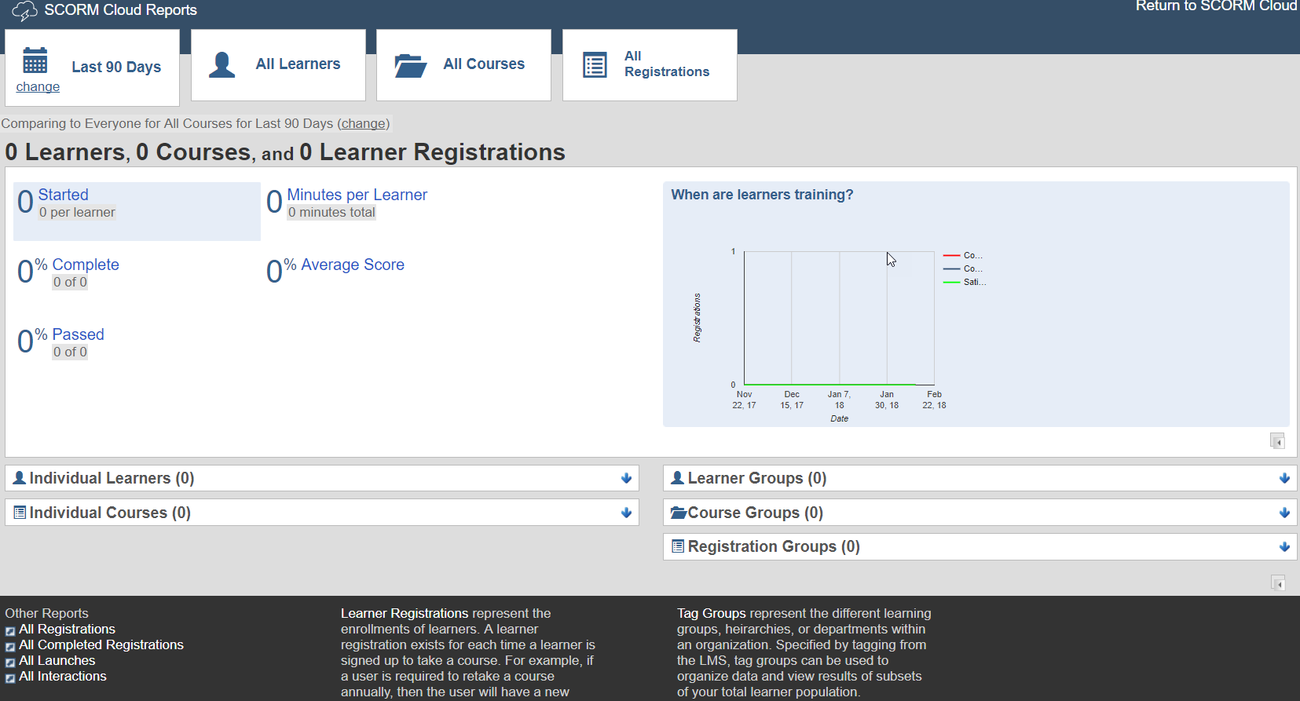
Simulations

Slide 22
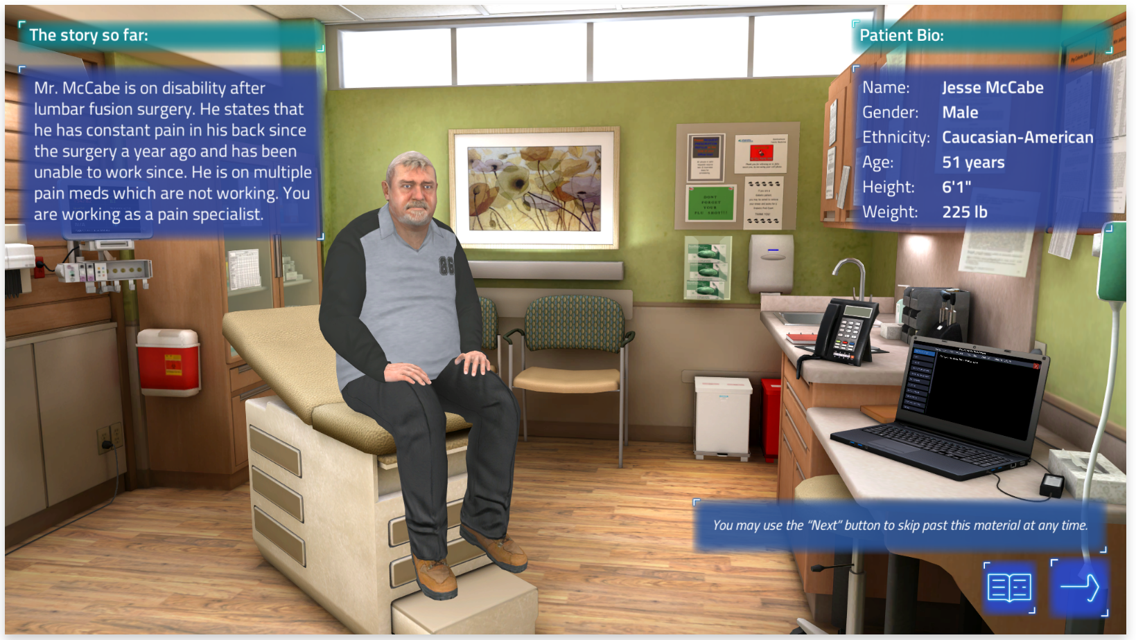
Simulations

Slide 23

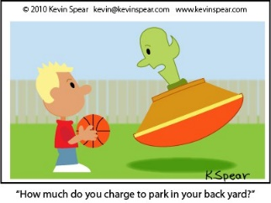
Gamification
Essentially a loyalty program that draws learners forward through content
Often used for sales and customer support roles
Games provide a light-hearted way to test knowledge
  Games frequently shoot aliens or cartoon characters in order for the learner to receive a question or as a reward for answering a question right
  Games often use quiz show formats
  Game skills have no relationship to work
  knowledge or skills
  Do not used PEAs
Leaderboards provide feedback on who receives highest scores (creates a degree of competition)

Slide 24

Collective Wisdom Exercise
5 Minutes
In groups of 2-3 brainstorm a list of tools and techniques.
Include at least one “stranger” (someone you just met today) in your group
Tools & Techniques
that create randomness or chance
Tools & Techniques
that create control
On this side of the room, discuss:
On this side of the room, discuss:
Notes:
Now that you have lots of images running around in your mind, let’s put those ideas to work on a short collective wisdom exercise.

Slide 25
What game mechanics (tools & techniques) generate randomness?
Notes:
When looking at a learning game or assessment game, what tools and techniques might you expect to see generating various degrees of randomness in play?

Slide 26
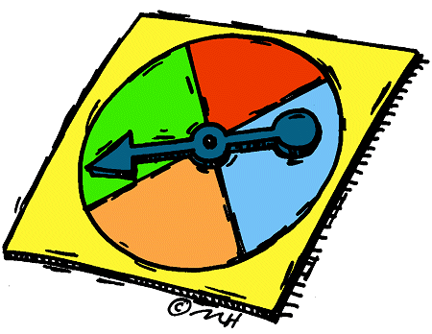
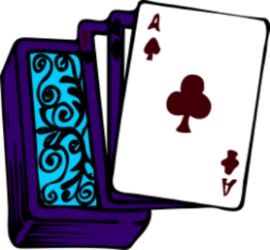
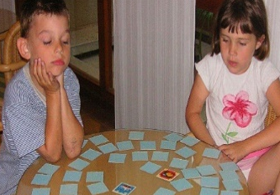

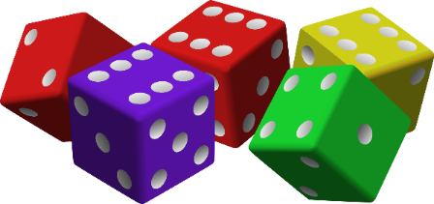
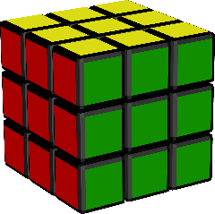
Randomness Techniques
Tools
Dice
Spinners & other random number generators
Shuffled cards
Layouts
  Chutes & Ladders
Board space instructions
  Pass Go/Go to Jail
  Draw a Community Chest card
Debrief
Actions of animated items
Natural occurrences
Human nature
Unexpected events
Memory – or guessing and lack of memory - challenges
  Old Maid type card games
Distractions - perception challenges requiring search & find
  Online games finding objects
Lack of directions – player chooses where to click
Notes:
Think back on our earlier discussion about how assessment methodologies balance the randomness and control factors. Randomness creates some of the sense of fidelity – match to the real world – as well as an arbitrariness. In assessment games, we have to manage randomness so that it reflects the real world fidelity while minimizing the sense of arbitrariness.

Slide 27
What techniques generate control?
Notes:
When looking at a learning game or assessment game, what tools and techniques might you expect to see generating various degrees of control in play?

Slide 28
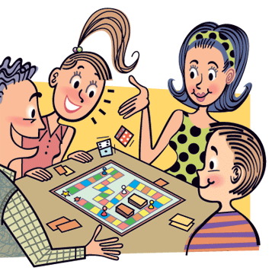
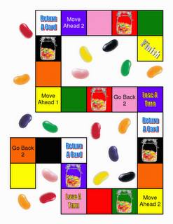

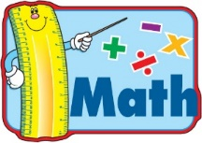
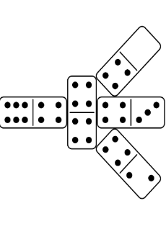
Control Techniques
Tools
Instructions
Rules
Layouts
Stages or levels in game
Defined interim success measures
  Buying houses/hotels
  Scoring points
  Finishing route/path first
Game pieces that provide new player capabilities
  Crowning a checker or pawn
Actions of control players
  Banker
  Role play script
Natural occurrences
Knowledge, skills, & abilities
Environmental limitations
PEAs
Failure
  Losing the level or game
  Losing points
Player developed strategies (learn)
  To gain points
  To meet success measures
Successful actions
  Accidentally doing it right
  Intentionally doing it right
Human nature creates controls where none exist
  Consider the “house” rules used by many families
Notes:
Think back on our earlier discussion about how assessment methodologies balance the randomness and control factors. Control limits opportunities and options. Too much control decreases the fidelity of real world experiences and decisions. Well-designed controls guide players forward to greater difficulty and complexity. Controls can also provide assessment feedback indicating that a player has not mastered skills at a given level of play.

Slide 29

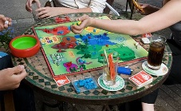

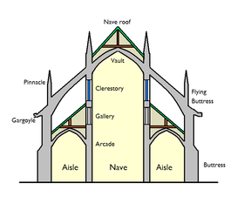
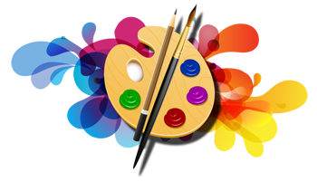






Learning is fun when opportunities for randomness and control challenge players to discover and apply deeper knowledge.
Notes:
Play creates deeper learning by triggering our primal skills that discover new knowledge and put it into application. Play creates relaxed attentiveness that deepens learning. Play creates eustress, which in turn decreases dysfunctional stresses. Fun, laughter, and community of result.
How effective is “play” at create a deeper more realistic assessments?

Slide 30

When learning is fun and challenging, the learner increases his or her own ability to control the randomness of the environment.
Application activities move us quickly to assessment. Simulation of an environment or key decisions allows us to assess player’s actions.
Assessments as Fun?
War games
Process games
A/R
V/R
Simulations
Notes:
We’re ready to look at not only games but group simulations (e.g., war games), augmented reality (A/R) – interacting with the real thing (a monster truck engine) through a computer interface that tracks every action, and virtual reality (V/R) – role-play simulations where the computer provides both randomness and control even as it scores results.

Slide 31
What is an Assessment
A process that integrates test information with information from other sources.
For example:
    Information from the individual’s social, educational, employment, or psychological history combined with a test score.
    Information from an credentialing eligibility application form plus one or more levels of exam scores.
    Scores from a game level or from A/R or V/R action or from observers of simulation actions, real work, or game actions
    Changes in an individual’s work record – decreased errors or increased customer satisfaction
APA Pg 3
Notes:
Judy

Slide 32
What is a Test
An evaluative device or procedure in which a sample of an examinee’s behavior in a specified domain is obtained and subsequently evaluated and scored using a standardized process.
A stimulus designed to elicit a sample of a taker's physical or intellectual behavior in a specified domain.
Along with the stimulus is a scoring procedure to allow user to measure, evaluate, and interpret the taker's behavior.
Any assessment device: opinionaire, performance checklist, portfolio, scale, inventory, multiple-choice, matching, fill-in, short answer, essay, in-basket exercise, role play, etc.
APA: Standard 1
Notes:
Judy

Slide 33
Game as Assessment
Attested as early as 2600 BC, games are a universal part of human experience and present in all cultures.
A game is a structured form of play, usually undertaken for enjoyment and sometimes used as an educational tool.
Games are distinct from work, which is usually carried out for remuneration, and from art, which is more often an expression of aesthetic or ideological elements.
Key components of games are goals, rules, challenge, and interaction. Games generally involve mental or physical stimulation, and often both. Many games help develop practical skills, serve as a form of exercise, or otherwise perform an educational, simulational, or psychological role.
Wikipedia,
June 26,2017
Notes:
Judy: Remember this one from earlier to day. It’s all about the performance of a role… a high or at least higher fidelity assessment experience than one gets from testing rote knowledge.

Slide 34
What is Evidence-Based Assessment
The assessment requires evidence of competence or capability through:
    Demonstration
    Attestation
    Artifacts
    Portfolio
Can games, virtual reality (V/R), augmented reality (A/R), role play, and simulations provide evidence
of competence and capability?
Notes:
Judy

Slide 35
What is most challenging about using a game as an assessment?
Games are fun; fun has no value in assessment
Games can have too many ‘right’ responses depending on the variables presented
Validation of many ‘right’ answers is too hard to do and too hard to demonstrate that our scoring is accurate and reasonable
Lack of technology to support scoring
Lack of rubric for complex scoring
Examiners may receive many requests for exception and appeals, because participants did not succeed or “pass” and they challenge the equivalency of their experience
Getting stakeholders and champions to accept the idea that game results are valid evidence which is closer to real work than a knowledge-based exam is
Notes:
Presenter: Stop at the title question. Get audience feedback. Summarize by reviewing list.

Slide 36
What would be the advantage for using a game as an assessment?
It’s closer to a real-world experience (higher fidelity)
Participants must have integrated many skills in order to play and, therefore, they demonstrate fluency in that integration
Play focuses on decisions and decision-based actions rather than on knowledge, but the player must really know the content (have the knowledge) in order to succeed
The game experience can be controlled to provide key interactions, decisions, and actions to all players; it can be standardized
The game experience can be randomized so that no two players experience the same stimulus in the same order, which makes it more difficult for players to “cheat” by copying others
Notes:
Presenter: Stop at the title question. Get audience feedback. Summarize by reviewing list.

Slide 37
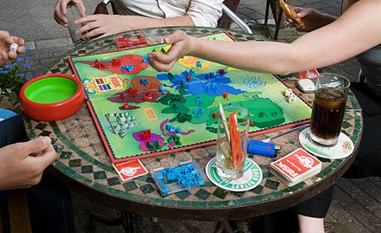



Tapping Your Experience
Can games be used as a valid form of evidence-based assessment and, in particular, for evidence used to certify individuals?
Notes:
Sharon and Judy

Slide 38
How can we make game-based actions as valid an assessment as rote knowledge for the purposes of demonstrating mastery or should games be reserved for fun and learning?
What Can You Do Next?
Notes:
Presenter (ask): Where will you go from here?

Slide 39
sThank You
FYI -- Training Magazine Network will be hosting
a Hale and Gander free webinar, Certifying Serious
Learning Games, Simulations, & Gamification Programs,
https://www.trainingmagnetwork.com/
June 6th Noon PT/ 2pm CT/ 3pm ET
Join us
Contact us at judy@halecenter.org
or sharon@halecenter.org
or dennis@dennisglenn.com

