Slide 1
Protection of Professional Certification in State Occupational Licensing Reform Legislation
December 4, 2019: Presentation to the Certification Network Group

Slide 2
Professional Certification Coalition
Started in 2018 to respond to legislative and regulatory activity at the state level that affects non-governmental, private certification organizations, the professionals they credential, and the public and other stakeholders who rely on those credentials.
Members (100+)
private professional certification organizations
membership associations/professional societies
service providers
Fields: health care, financial services, engineering, information technology, safety association management, human resources, etc.
Mission: Serve as the voice of those who use or rely on professional certification by advocating for sound legislative initiatives and educating stakeholders about private professional certification.

Slide 3
Professional Certification
Key elements:
Voluntary
Usually granted by non-governmental (mostly nonprofit) organizations
Reflects established standards of knowledge, skills and/or competencies in the field, as identified by subject matter experts in that field
Credential issued only to individuals who can establish that they have the necessary qualifications
Key Benefits
Promotes competition and informed choice in selecting professional providers
Enables the public to distinguish between those who have attained some qualifications from those who haven’t
Provides a way for people pursuing careers in specialized fields to identify the skills/knowledge base they need to master for a specific profession and to demonstrate that mastery

Slide 4
Issues Affecting Professional Certification in Occupational Licensing Reform Efforts
Defining the terms “certified” and “registered” as titles that only the government can issue and including provisions barring people from using those titles without state authorization, thereby precluding individuals from marketing themselves as having earned their credentials.
Characterizing “certification” as a recognition issued only by the government or calling for state action to offer voluntary certification programs, which, contrary to free-market principles, would position the government as a competitor to private certification programs and unnecessarily spend taxpayer money.
Ensuring that legislation aiming to provide opportunities for ex-offenders is balanced against the need to protect the public; avoiding unconstitutional intrusions into private certification organizations’ rights to define the standards for their credentials.

Slide 5
PCC Principles for Occupational Licensing Reform
Avoid restricting or intruding on the important role of voluntary professional certification programs
State legislators/regulators should conduct careful review before repealing any current requirements for professional certification in licensure statutes and regulations; and
Ensure balanced standards for determining whether an occupational licensing regime for a certain field should be renewed
Particular focus on recognizing that the public expects licensure laws to set a higher bar than merely protecting them from gross negligence and injury

Slide 6
Enforcement Function of State Regulators
In some fields, such as health care, safety-related roles, and the engineering and financial industries, state agencies have incorporated competency standards established by non-governmental certification programs into licensure requirements.
These requirements acknowledge both the importance of setting competency standards for protecting the public and the value of having those standards defined by subject matter experts.
For these professions, content of standards is best established by the non-governmental professional certification program, but enforcement of standards is more effectively done by the licensing agency.
In professions for which state licensing boards have historically provided oversight, it would not serve the interests either of the public or of private certification organizations to weaken licensure requirements and shift the enforcement function currently performed by licensure boards onto private certification programs.

Slide 7
PCC Principles for Ex-Offender Reentry Legislation
Private certification organizations and professional societies have a Constitutional right to define and enforce ethics and conduct codes for their credential-holders and members.
Private certifications convey to the public that the credential-holder meets all of the eligibility, qualification, competence, and conduct requirements of that organization’s standards and policies.
To protect the public from unacceptable risks, some criminal convictions permanently and automatically disqualify offenders from holding certain professional certifications, even if the conviction was for a non-violent charge or a number of years have elapsed since the conviction.

Slide 8
PCC Principles for Ex-Offender Reentry Legislation (cont’d)
Conduct requirements for conforming with the high standards established for private professional certifications often overlap with legal requirements that carry criminal penalties.
Private certification organizations lack both the legal authority and the resources to engage in a full- fledged independent investigation and fact-finding hearings about violations of ethics and conduct rules.
Restricting consideration of criminal convictions based on whether they are felonies or misdemeanors is unwarranted, because the underlying conduct may be the same.
Where private certification is a condition of licensure, that requirement reflects the considered judgment of the legislature or the licensure agency that the standards established by the recognized credentialing organization for the profession are necessary to protect the public.

Slide 9
Key Message
The worthy objectives of occupational licensing reform should be balanced with protections to public health, safety and welfare derived from professional certification and shouldn’t create any obstacles to informed consumer choice in seeking high quality professional services.

Slide 10
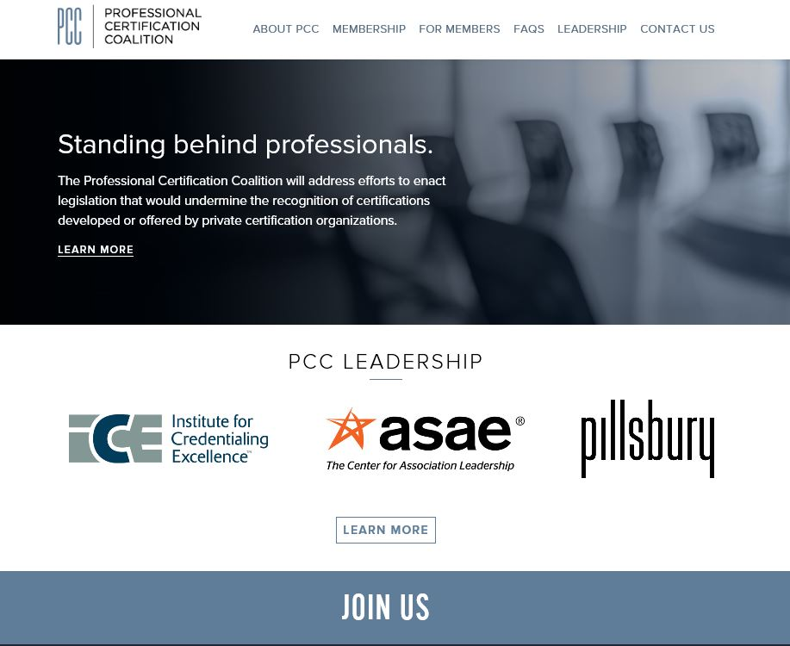
For more info on the PCC, please visit profcertcoalition.org.

Slide 11
QUESTIONS?

