Slide 1
CNG December 4, 2019 Topic: Quality Management for New and Small Volume Certification Programs Presenter: Allison Barton-Kramer Director of Certification ASBO International ASBO International ASBO International abarton-Kramer@asbointl.org

Slide 2
THE ISO QUALITY MANAGEMENT PROCESS
WHAT IS IT?
A continuous process of internal and external review of your business and management systems to:
Verify the system is working the way it is supposed to
Find out where it can be improved
Correct or prevent problems identified

Slide 3
THE ISO QUALITY MANAGEMENT PROCESS
WHAT ARE THE BENEFITS?
Certifies that the Certification Process is of world class quality
Provides a systematic process to improve individual and organizational efficiency
Protects the organization against any legal suits based on quality standards

Slide 4
THE ISO QUALITY MANAGEMENT PROCESS
WHAT IS THE METHODOLOGY?
Identify the Problem
Analyze the Impact
Solve the Problem
Example of a Quality Management Methodology for process improvement:
Plan Do Check Act
Stresses top management support for improving quality.
Plan – identity the problem
Do- seek potential solutions
Check- study the results
Act – implement the best solution

Slide 5
Workflow Management Checklist
Create an outline of your program by using a flowchart
Rely on supporting staff for documentation (record keeping)
Collect feedback
Communicate the benefits of quality management throughout your organization to ensure buy-in
Encourage a culture of teamwork
Evaluate and monitor your progress
Address concerns and how they will be addressed
Avoid complacency
Happiness is not the absence of challenges,
but the ability to cope with them.
Notes:
Flowcharts serve as a guide to identify your production process and quickly pinpoint problem areas.
It also for identifying responsibilities and establishing how or who performs the tasks
Use the flowchart to communicate how a process should work
Understand the major areas of workflow that are impacted
Which areas to assign to a team
Identify if you have duplication of tasks or if some areas are overextended
2. Documentation is important because it will help to pinpoint the origins of a specific problem. Rely on committees for record keeping. Provide story here.
Collect feedback from members & staff. Seek feedback to identify areas for improvement. This will help to create a more factual approach to decision making.
4. Quality management techniques require buy-in and engagement at all levels in order to work effectively.
5. Ensure that managers work as part of their teams, rather than as overseers. In high pressure situations, a decision may be overruled resulting in faulty outcomes
6. quality management is a long-term process seeking to make continual, small improvements over time

Slide 6
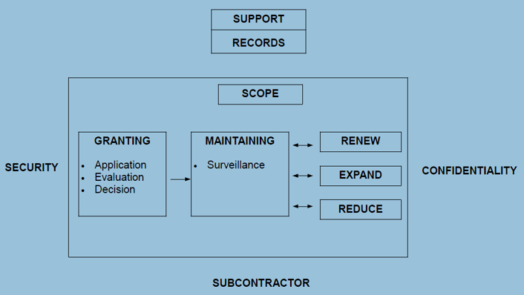
Example of Workflow Mapping
Notes:
Workflow mapping is crucial because charting the course of a process visually helps to breakdown complex processes
Use the flowchart to communicate how a process should work
Understand the major areas of workflow that are impacted
Which areas to assign to a team
Identify if you have duplication of tasks or if some areas are overextended

Slide 7
THE ISO QUALITY MANAGEMENT PROCESS
Documentation: To assure the ongoing documentation of the Certification body’s policies and procedures
Document Control: To assure that documentation is maintained, updated, and distributed to employees
Internal Audit: To annually evaluate whether procedures are consistent with standards
Management Review Systems: To actively assure that documented procedures and processes are being applied effectively through
o Continuous Improvement
o Corrective Actions
o Preventive Actions
Sourced from ISO 9001 – Quality Management System

