Slide 2
For Today’s Session
Mute your audio connection (if you are not already muted)
Speaker will use video; attendees may choose to use video or not
Submit questions through the chat feature
Session is being recorded and will be available after the session

Slide 3
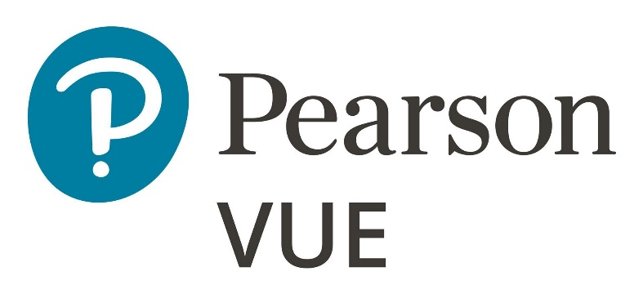
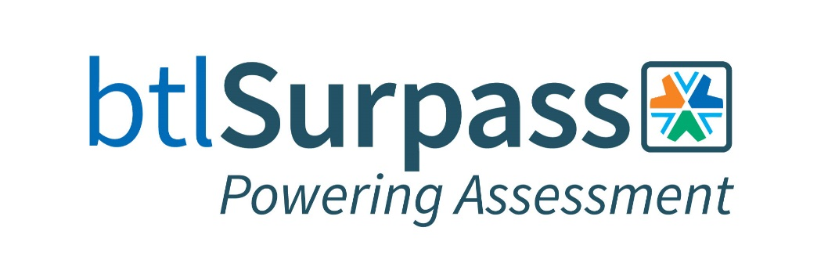
Thank you to our Full CNG DC Sponsors!

Slide 4
Thank you to our Supporting Sponsors!

Slide 5
Thank you!
Today’s Showcase Sponsors

Slide 6
CNG Meeting PSI - Assessment & Science Focused
ic
Isabelle Gonthier, PhD Senior Vice President, Assessment Services
Isabelle.Gonthier@psionline.com
913-368-8496

Slide 7
Proven Resources and Scalability
Over
17 million
assessments
delivered annually with 4M via live online proctoring
Test Center Network
Spanning five continents & 120+ countries
185 staff
focused on
R&D, Product Development & Innovation
50+
Psychometricians & Psychologists, with
13 devoted to Certification
Delivering Assessment
& Development Solutions for
75 years
Programs in
160 countries
2,200+
employees
1,000’s
of Proprietary Exams & Talent Assessments
Assessments in
50+
languages

Slide 8
The PSI Psychometrics Difference
Partnership & Expertise
Flexible & Innovative
Accreditation: Guidance & Adherence
Scope: Breath & Depth

Slide 9
PSI’s Data Forensics Program
Surveillance Monitoring for Testing Anomaly
Supported by a team of psychometricians who work directly with Global Security to pinpoint flagged behavior for targeted site audits gaining valuable operational evidence
Uses a suite of statistical indices to cover a wide range of cheating activity, including Pass Rate Elevations, Score Gain Analysis, and Item level analysis
Stratified across predefined groups (for example, geographical location or education provider) to pinpoint fraudulent activity
Ongoing summaries of activity and flagged candidate and exam lists.
Comprehensive Reports and presentation of results
Introduction of web crawling for Client Partners
Candidate-Level Scan
Abnormal Response Similarity Irregular Item Response Patterns
Unusual Response Time Patterns
Test Program-Level Scan
Exam
Form
Group-Level Scan
Delivery Modality (RP vs TP)
Geographical Area
Client-defined groups
Executive Summaries
Annual Report

Slide 10
Thank You & Enjoy the CNG Meeting!
psionline.com

Slide 11
Online Proctoring for Certification Programs
Wednesday, October 27, 2021

Slide 12
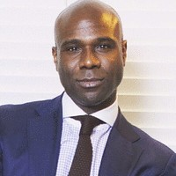
Introduction
Kahlil Blazia
Director,
Business Development
Notes:
Use this page to introduce yourself and any other Examity staff who are on the call

Slide 13
Secure • Convenient • Cost-effective
Notes:
Just do a quick 30 second-1 minute elevator pitch as to who Examity is and how we’re participating in the marketplace

Slide 14
Value of Certifications
Seamless and Secure Online Proctoring with Examity Offers:
Content Security
Credential Protection
Scalable
Cost-Effective
Convenient
Notes:
Test anytime, anywhere: Flexibility is the key to success. Our Solution is available 24/7/365, so your candidates can complete their exam when and where it is most convenient.
Increase your candidate pool: more choices means more opportunity to find the best employees. Increase the amount of available talent by testing candidates online.
Reduce hiring cycle time: Time is crucial when securing top talent. Attract and hire faster by removing the barrier of in-person testing.
Advance top talent: keep your employees happy by helping them advance faster. Online testing can help you retain your most valuable talent.

Slide 15
Thank You
Thank you for taking the time
to attend today’s session!
Curious to learn more?
Please reach out to Kahlil at kblazia@examity.com
or visit us online at Examity.com

Slide 16
Ways to Approach and Develop Your Organization’s Value Proposition
What is meant by Value Proposition of Certification?
How does an organization create a value proposition for the certification?
What can you learn from a value proposition study?
How can a credentialing organization use the results?

Slide 17
Today’s Speakers
Jason D. Way, PhD Senior Research Psychologist, ACT
Jason Way is a senior research psychologist on the Social, Emotional, and Academic Learning Research team.
His research interests include the assessment and development of behavioral and psychosocial skills, including their relevance to important academic and work outcomes.

Slide 18
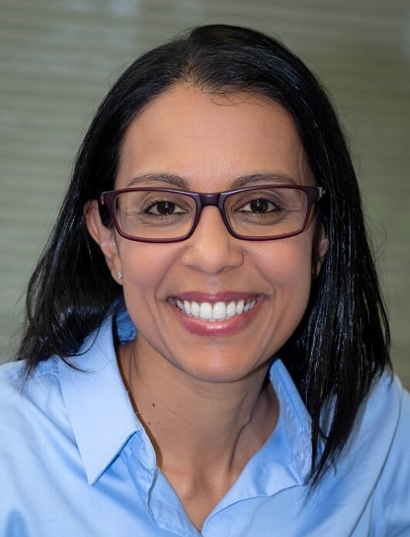
Today’s Speakers
Usma Mohamed Vice President of Brand, Experience and Marketing, CFPR
Usma Mohamed serves as the Vice President of Brand Experience and Marketing at the Council for Professional Recognition, responsible for the overall marketing results of the organization, oversees the integrity of the brand, communications, and marketing strategies as well as efforts to strengthen the organization’s market position to achieve the desired mission, objective, and goals.
Usma brings more than 20 years of brand and marketing experience in commercial and international not-for-profit organizations. Prior to joining the Council, she was the Global Head of Marketing and Communications at the International Baccalaureate (IB), a leading global education nonprofit. She has led various international change management initiatives and branding and marketing campaigns in various languages and international settings. She has spoken at multiple international conferences and events worldwide, including the National Press Club in Washington, DC. Her academic credentials include an advanced level education from the U.K., a Bachelor of Science degree in International Marketing Management, and a Master’s in Nonprofit and Association Management from the University of Maryland.

Slide 19
Today’s Speakers
Ty Kenworthy Manager, Research Services & Business Development Manager – Pearson VUE
Ty Kenworthy oversees Pearson VUE’s research efforts in the IT certification market in addition to working as a Business Development Manager in that same space.
Ty’s educational background is in qualitative research methods and Cultural Anthropology. He has been with Pearson VUE and their Certiport business since early 2010.

Slide 20
ACT’s Efficacy Framework

Slide 21
What happens when products don’t live up to their claims?
1. Disappointed customers, tarnished brand

Slide 22
2. Worse, there could be legal implications….

Slide 23
Guiding Validity Work at ACT
Guiding Efficacy Work at ACT
Standards for Educational and Psychological Testing
?

Slide 24
Evidence of Validity
Validity Argument
As described in The Standards, validity refers to the degree to which evidence and theory support the interpretation of test scores for proposed uses of tests (2014).
Types of Evidence Supporting a Validity Argument
The Standards identify five sources of validity evidence for tests. A description of each of the sources of validity evidence is provided below.
Evidence based on Test Content
Evidence based on Response Processes
Evidence based on Internal Structure
Evidence based on Relations to Other Variables.
Evidence based on Consequences of Testing

Slide 25
Typical Research Activities Employed to Elicit Different Sources of Validity Evidence
Evidence | Research Activities
Content | Alignment Study
 | Curriculum Survey
 | Standard Setting
 | Job Analyses/Profiling
 | Course Catalog Review
 | Job Description Review
 | Customer Survey
Response Process | Cog Lab
 | Think Aloud Interview
 | Eye Tracking Study
 | Item Latency Analysis
Internal Structure | Item Statistics
 | Equating Study
 | Differential Item Functioning
 | Dimensionality
 | Measurement Invariance
 | Reliability

Slide 26
Typical Research Activities Employed to Elicit Different Sources of Validity Evidence
Evidence | Research Activities
Relations to Other Variables | Validity Study
 | Concordance Study
 | Differential Validity
 | Differential Prediction
 | Subgroup Analysis
 | Empirical Standard Setting
Consequences of Testing | Efficacy Study
 | Efficacy Trial
 | Return on Investment
 | Impact Analysis

Slide 27
Evidence of Efficacy
Efficacy Argument
Efficacy refers to the degree to which evidence, rationales, and theory support the claim that a learning tool improves intended learner outcomes.

Slide 28
Outcomes Framework
Impact
Behavior
Learning
Reaction
Kirkpatrick’s Evaluation Model

Slide 29
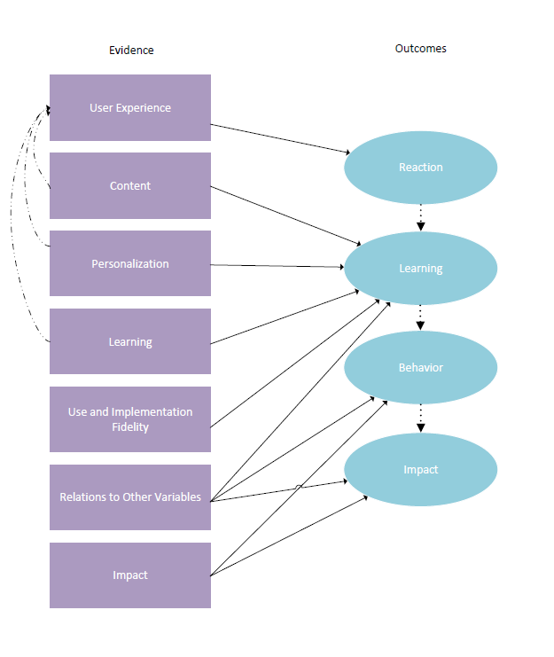
Types of Evidence Supporting an Efficacy Argument

Slide 30
Typical Research Activities Employed to Elicit Different Sources of Efficacy Evidence
Evidence | Research Activities
User Experience | A/B Testing
 | Cog Lab
 | Think Aloud Interview
 | Eye Tracking Study
 | Focus Group
 | Customer Survey
 | UX Research
 | Game Design/Gamification
 | Rapid Prototype Testing
 | Net Promoter Score
Content | Alignment Study
 | Curriculum Survey
 | Standard Setting
 | Job Analysis/Profiling
 | Course Catalog Review
 | Job Description Review
 | Customer Survey

Slide 31
Typical Research Activities Employed to Elicit Different Sources of Efficacy Evidence
Evidence | Research Activities
Personalization | Model and Algorithm Design
 | Algorithm Development & Iteration
Learning | Learning Principles
 | Efficacy Study
 | Efficacy Trial
Use And Implementation Fidelity | Implementation Study
 | Effectiveness Study
 | Case Study
Relations to Other Variables | Validity Study
 | Differential Validity
 | Differential Prediction
Impact | Efficacy Study
 | Efficacy Trial

Slide 32
Integration of a Validity Argument and an Efficacy Argument into an Efficacy Framework

Slide 33
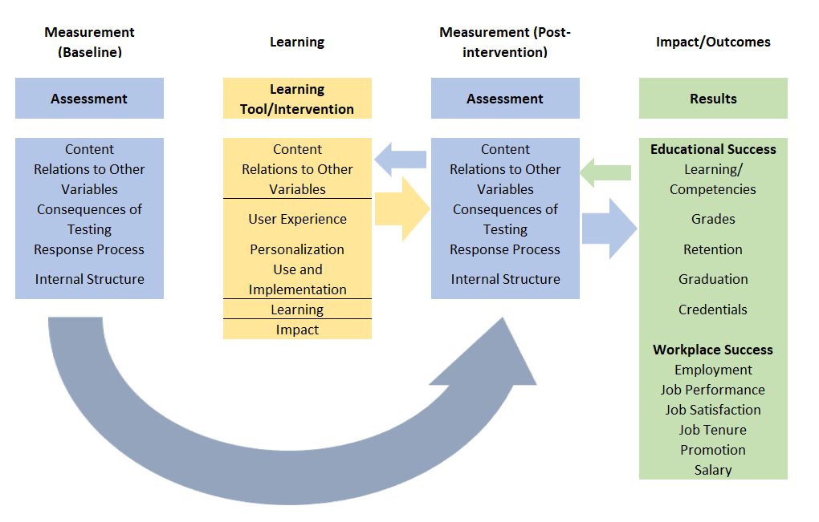
ACT’s Efficacy Framework: Alignment of Validity and Efficacy Evidence

Slide 34
Types of Efficacy Claims
Type of Efficacy Claim | Study Designs
Anecdotal/ Qualitative Claims | Customer Feedback/ Endorsements
 | Focus Groups
Descriptive Claims | Surveys
 | Secondary analysis of administrative data
 | Cohort analysis with no controls
Correlational/Predictive Claims | Cohort analysis with controls
 | Cohort analysis with no controls
Comparative Claims | Quasi-experimental
 | Randomized controlled trial
Causal Claims | Randomized controlled trial
 | Propensity score matching
 | Instrumental variables
 | Regression discontinuity
Criteria:
Use case
Stage of the product life cycle
Desired strength of validity or efficacy claim and funding
Intended Audience
Return of investment/ investment risk

Slide 35
Validity and Efficacy Research
1. Development
of a Theory of Action
2. Claims Documentation
3. Gap Analysis
4. Research Agenda Setting and Prioritization
5. Executing Research Studies and Publish Findings
Notes:
How do we determine what validity and efficacy research is needed and how do we prioritize which validity and efficacy studies we conduct.
For each existing and new ACT product, we create a theory of action (TOA) for the product
Based on the TOA, we document the validity and efficacy claims we are making for our product as well as what evidence we have to support each claim
Gaps in evidence are identified (i.e., we want to make a claim that test prep improves ACT performance but we don’t have empirical evidence showing the relationship between AOP usage and ACT performance; only theoretical evidence)
This gap analysis informs the research agenda setting process and prioritization. Claims that are most central to an ACT product but lack evidence drive the research agenda setting process.
Research studies are designed and executed to address identified gaps and priorities. Findings are published. Based on the findings, the TOA may be revised.

Slide 36
Questions?

Slide 37
Value Proposition
Usma Mohamed
VP Brand Experience and Marketing
Council for Professional Recognition, Washington DC.

Slide 38
Focus for Today
What a Value Proposition
Creating a Value Proposition
Steps to Success
The Fantastic 4 !
Example in Action
Questions to Consider
Continuous Improvement

Slide 39
What a Value Proposition is NOT
Logo
Images
Messaging
Data
Tagline

Slide 40
Value Proposition (it’s about the customer!)
Why customers should choose your product over competitors?
How the product/service offered will be the solution they are looking for?
What outcomes and benefits can the customer expect?

Slide 41
The Interconnection
Organization Offering
What the Customer Needs
Market Place Offerings
Value Proposition

Slide 42
Steps
Demonstrate
All the benefits the product.
Describe
Describe what makes these benefits valuable.
Identify
Identify your customer's main problem.
Connect
Connect this value to your buyer’s/customers problem.
Differentiate
Differentiate yourself as the preferred provider – through value, quality or cost effectiveness

Slide 43
Fantastic Four
Headline
Subhead
Three bullet points
Visual

Slide 44
Example
Headline
Child Development Associate Credential® (CDA)
Subhead
Advancement into the early childhood education sector
Three Bullets
Based on a core set of competency standards.
Nationally-transferable recognized by the profession as a vital part of educator preparation and development.
Creates confident practitioners with command of today’s best practices for teaching young children
Visual

Slide 45
Stakeholder Theory
Internal Stakeholders
Board members
Internal staff
External Stakeholders
Parents
State Administrators
Educators
This Photo by Unknown Author is licensed under CC BY

Slide 46
Questions to consider to inform VP
Internal
External
What resources do you have that will support this product ?
What additional resources do you need?
Do you feel this certification would be valuable to X stakeholder?
What other certifications would compete with this ?
Does the product offering align with our brand?
What are some concerns you have ?
Would you find this product valuable ?
Would the price of X make sense for this product?
Who should pay for this product?
Should it be a required credential?
Do you think your employer would recognize this certificate?
Is there another “product” you would consider? And if so, why?
Is there a grant or funding source that would pay for this?
What other credentials do you have ?

Slide 47
Gathering Feedback to Inform VP
Focus Groups
Surveys
Pilot

Slide 48
Reach your stakeholders
Email
Identified stakeholders
Social
General Audience
In-person responses (events , Interviews and focus groups)

Slide 49
Continuous Improvement
Evaluation approaches ( listen and observe)
Solicit Feedback
Analyze data and information
Prioritize
Implement
Repeat!

Slide 50
Thank You!

Slide 51
Value of IT Certification to Candidates and Employers
Presented by
Ty Kenworthy, Pearson VUE

Slide 52
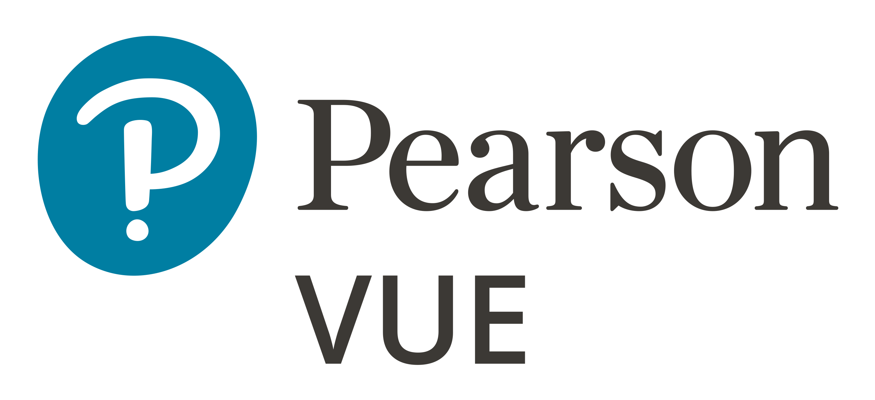
Key Findings
In 2021
Demand Growth
Top Motivation
Delivers ROI
Lifelong Pursuit
Notes:
So what do we have to say about IT Certification in this year’s report? A lot. But after months of analysis, we are comfortable boiling down the results into four key findings: first, we see a growing demand for IT certification; second, we better understand candidate’s primary motivations for pursuing IT certification; third, we have expanded insight into the return on investment for IT certification to both employees and employers; and fourth, we better understand the lifelong credentialing journey of candidates who pursue IT certification.

Slide 53
Candidates: Top motivation behind IT certification is a desire to upskill
Most important reason for pursuing IT certification
Obtain skills, knowledge, or competence
44%
Advancement / promotion in current job
22%
Enhance professional profile / resume
14%
Make a job change
8%
Obtain a specific IT role
7%
Find work (I am under or unemployed)
5%
“Increased knowledge is the most important to me, because I want to know this stuff, not just have a pretty piece of paper hanging on my wall.”
– CompTIA Networking & Wireless certification candidate, United States
Notes:
And based on survey responses, the top motivation for candidates seeking IT certification is to obtain skills, knowledge and competence. [click] In fact, while an astonishing 44% of respondents cited upskilling as their most important reason for seeking IT certification, 73% of respondents cited it as at least one of their motivating factors. That is so pure to me. The thirst for learning and self-improvement is an endearing and noble pursuit. I really appreciated this response from one of CompTIA’s candidates: “Increased knowledge is the most important to me, because I want to know this stuff, not just have a pretty piece of paper hanging on my wall.”

Slide 54
Candidates: Top motivation behind IT certification is a desire to upskill
Most important reason for pursuing IT certification
Obtain skills, knowledge, or competence
44%
Advancement / promotion in current job
22%
Enhance professional profile / resume
14%
Make a job change
8%
Obtain a specific IT role
7%
Find work (I am under or unemployed)
5%
“I have been chasing a promotion for quite some time. I decided to better myself and attain my Blueprint certification and I believe this was part of the reason that I was promoted during a hard time for any business during COVID.”
– Facebook Blueprint Business Skills certification candidate, Australia
Notes:
The motivation ranked as second most important was to obtain advancement or a promotion. 56% of all respondents cited this as a motivation for pursuing certification, with 22% reporting it as the most important. Most of these candidates ended up realizing their goal to obtain advancement or promotion as a result of their certification, which I will share more about momentarily. This had to be especially meaningful to employees who needed that boost during the pandemic. As one respondent from Australia reported: “I have been chasing a promotion for quite some time. I decided to better myself and attain my [Facebook] Blueprint certification and I believe this was part of the reason that I was promoted during a hard time for any business during COVID.”

Slide 55
Candidates: Top motivation behind IT certification is a desire to upskill
Most important reason for pursuing IT certification
Obtain skills, knowledge, or competence
44%
Advancement / promotion in current job
22%
Enhance professional profile / resume
14%
Make a job change
8%
Obtain a specific IT role
7%
Find work (I am under or unemployed)
5%
“To strengthen my résumé by adding [an] official certification to my experiences.”
– Cisco Security certification candidate, Saudi Arabia
Notes:
And the third most important motivation employees had for seeking certification was to enhance their professional profile or resume. Here again, 56% reported this as one factor in their pursuit of IT certification, and 14% identified it as their primary reason.
Whether seeking to upskill, get a new job, or boost their resume, our data shows that candidates seeking IT certification had clear objectives in mind as they learned, developed, and ultimately certified their new or refreshed skills.

Slide 56
Certified Employees: IT certification delivers significant ROI
New job
7 in 10 candidates met their goals for certification
Pay raise
Promotion
Notes:
And we know that most of these candidates obtained the goal they were pursuing through certification. At the time of the survey, 7 in 10 respondents reported having met their goals for certification and 26% still anticipated achieving those goals but hadn’t yet at the time they were surveyed. [click] Despite hiring freezes, staff reductions, and other job-related impacts companies and employees experienced due to the pandemic, 36% of candidates had already obtained a new job due to their certification and 21% were promoted in their current job.
28% reported getting a raise. Now this rate is down 7% from last year—based on other industry reports along with feedback to our survey we suspect this is more a result of tighter expense controls instituted by companies during the pandemic than a reflection of waning value in the certifications earned. Of those who saw a pay increase, 55% saw that increase within 3 months of earning their credential, with 77% of employees seeing that increase within 6 months. And, in some great cosmic balancing act, though the rate of candidates obtaining raises was down from last year, the value of the raises earned was up. 50% of these candidates saw a pay increase between 6 & 20% - which is much higher than the average 2020 salary increase of 2.5%.

Slide 57
Certified Employees: IT certification delivers significant ROI
Benefits of certification to candidates
91%
84%
80%
76%
76%
74%
Increased confidence in abilities
Determination to succeed
Interest in new opportunities
Increased job satisfaction
Respect from peers
More work autonomy
Notes:
It’s tempting to see these material, financial benefits of IT certification to candidates and extol the ROI based on those figures alone. But candidates reported other intrinsic benefits to certification that are significantly impactful on their own.
Whether it is an increased confidence if your abilities and skills, a broadening of horizons and interest in pursuing new opportunities, or increased job satisfaction and autonomy, IT certification dramatically improves many facets of an employees’ worklife. These are the less tangible, but no less critical benefits that can mitigate real issues like burnout, overly high turnover, and employees feeling stuck or trapped in a job.

Slide 58
Employers: IT certification delivers significant ROI
Benefits of certification to employers
81%
80%
77%
75%
72%
71%
Increased quality of work
Increased mentoring
Greater innovation & problem solving
Able to complete new tasks
Increased efficiency
Increased productivity
Notes:
Survey respondents who were also hiring managers reported equally impactful intrinsic benefits to companies and employers. They cited IT certification as contributing to improvements in employees quality of work, increases in innovation and problem solving, and greater efficiency and productivity levels among certified employees. Increased mentoring also ranked high among benefits of certified employees.
Considering these and other factors in a separate independent study, Global Knowledge’s 2020 IT Skills and Salary Report estimates that the ROI per credentialed employee to be ten thousand dollars in added value. That figure alone is a mic-drop moment for why companies should prioritize IT certification in their training and hiring activities.

Slide 59
IT Employer Value of Certification Report
of managers reported managing IT certified employees in the last 12 months.
IT managers feel that awareness of the latest technologies is the biggest advantage of having and maintaining IT certification.
They also feel that IT credentialed employees are better connected with industry professionals and resources.
97%
Notes:
Critically, our Employer Value of Certification research largely confirmed the insights we learned from the hiring managers that responded in our Candidate Value of Certification survey. Our research with employers, however, provided additional context for the results we previously obtained. For instance, we were able to better understand just how embedded IT certification is within companies and in the hearts and minds of employees. [click] When we asked managers whether they had managed employees with IT certifications in the last 12-months, 97% reported that they had. That is an astonishing percentage that demonstrates not only the prevalence of IT certifications in the workforce, but managers’ awareness of certification among their employees.
[click] And no wonder they are aware of it. In interviews and survey responses, IT managers affirmed that their certified employees were more aware of the latest technologies—including how they are used and the skills needed to implement and maintain them—and they saw this as a crucial advantage to their business, uniquely provided them through their IT certified employees.
[click] Additionally, employers observed that IT certified employees appeared better connected with other professionals and resources in their industry. These connections can provide these businesses with a richer flow of ideas, talent, and skill—all critical to maintaining a competitive edge in their markets.
Here are a few more juicy tidbits from our research with managers and employers.

Slide 60
IT Employer Value of Certification Report
Employers are prioritizing upskilling efforts
of companies surveyed cover all IT staff training and credentialing costs
63%
Notes:
First, we do see a majority of employers prioritizing upskilling, training, and development initiatives among their employees. 63% of companies surveyed cover all costs of training and credentialing for their IT employees. This is such an incredible benefit to employees, and, as we’ve shared already, a benefit that returns back to the company in significant ways. As a personal aside, I hope this number is 100% someday soon.

Slide 61
IT Employer Value of Certification Report
Employers are prioritizing upskilling efforts
of IT managers are significantly more likely to review job applications with IT certifications
60%
IT certifications help employers find and hire top talent
Notes:
Second, IT certifications play an important role as employers find and hire the best talent. 60% of the IT managers managers we surveyed stated that job applications with IT certifications listed were significantly more likely to be reviewed. In competitive job markets, like we often see in the IT segment, job candidate’s need to maximize any advantage to even get an interview. With the numbers we’ve reviewed here today, it’s my opinion that we are fast approaching the point where IT certifications are simply table stakes for job applicants in the IT segment.

Slide 62
IT Employer Value of Certification Report
Employers are prioritizing upskilling efforts
of IT managers claim that IT certified employees produce higher-quality work
66%
IT certifications help employers find and hire top talent
Certified employees perform at a level above their peers
Notes:
Finally, IT managers report that their IT certified employees noticeably outperform their non-credentialed peers, helping them to assess a measurable return on employer investment. These managers cited especially that IT certified employees generally produce higher quality work.
There are even more insights like these in our Employer Value of Certification report—insights that only further demonstrate just how valuable IT certifications are to businesses and IT groups.
Look for the complete Employer Value of Certification report from Pearson VUE very soon.

Slide 63
Demand for IT certification has grown… and will continue to grow
increase in Pearson VUE IT exam volumes over the previous year
of candidates plan to pursue additional certification in ’21-’22
16%
86%
Notes:
In fact, the IT certification market was stronger than ever last year. Exam deliveries in 2020 were up 16% over the previous year—and that is even with testing grinding nearly to a halt in March 2020 and building up through June as IT certification sponsors embraced or expanded their online proctoring offerings.
And while IT certification volumes have enjoyed consistent year-over-year growth for the past decade, this level of growth during one of the most costly, disruptive, and tragic pandemics in recent history is astonishing.
[click] Candidate responses to our survey give us confidence that this growth is not slowing down any time soon, either. 86% of respondents indicated that they were likely to pursue additional training and certification in the next year. This is a significant percentage that indicates confidence in continued growth in IT certifications. The rapid pace of change in technologies has largely driven this growth over time. The pandemic accelerated this for many companies by forcing a comprehensive shift in the ways that companies use technology to power their customer solutions and internal management. It prompted many companies to adopt the latest cloud, cybersecurity, and software development technologies faster than they had planned pre-pandemic. Consequently, employees had to just as quickly learn and develop the commensurate skills to keep pace with the changes. And all signs point to this being the beginning of a trend rather than a one-time catch up.

Slide 64
Demand for IT certification has grown… and will continue to grow
Percent of candidates who have pursued or plan to pursue certification by domain specialty
SPECIALTY | 2019 | 2020 | 2021-22
Cloud Computing (IaaS, PaaS and SaaS) | 11% | 28% | 50%
Networking and Wireless | 19% | 15% | 23%
Virtualization | 7% | 7% | 28%
Cybersecurity | NA | 7% | 33%
Security | 16% | 6% | 27%
Servers | 5% | 5% | 22%
Application (Software) Development | 5% | 4% | 14%
Analytics, Big Data and Data Warehouse | 4% | 3% | 18%
Database Administration and Development | 6% | 3% | 12%
Enterprise Architecture | 2% | 3% | 9%
Notes:
Respondents have given us insight into the changing landscape of priority skills in IT that they are pursuing now and have plans to pursue in the very near future. With many companies now supporting distributed workforces, and more customers expecting to consume services in ways and places convenient to them, it shouldn’t be too surprising to see Cloud Computing make huge gains in 2020/2021 over 2019. And even less surprising to see its continued growth forecasted in 2021 and 2022. The same can be said for Networking and Wireless, Virtualization, Cybersecurity and Security skills with forecasted growth rates of 60%, 324%, 405%, and 366%, respectively. IT employers and employees have adapted and continue to adapt to the rapidly changing technology landscape and market demands which shows no sign of stopping soon.

Slide 65
IT credentialing is a lifelong pursuit
First-time vs. multiple credentials
Notes:
When employees and employers consider the material and intrinsic benefits from IT certification, it is little wonder that we see employees making IT credentialing a lifelong pursuit. [click] 72% of respondents to our 2021 survey already held multiple professional certifications. [click] We see most candidates coming from industry, particularly within the first two years of working in a new career.
These candidates are pursuing certifications across a range of titles and programs. In fact, 97% of the respondents who reported holding multiple certifications held those certifications in several programs or solutions—with some reporting being certified in as many as 10 separate programs. This suggests an orientation towards a general competency in a broad-range of skills verses deep expertise in a narrow-range of skills, at least at the outset of ones career. This makes sense, too, as you see the peak certification activity happening just before or just as one begins their career journey and then narrowing as their career progresses.

Slide 66
IT credentialing is a lifelong pursuit
9.8
Career-long value of certification is evident by the growth in average certifications held per candidate over their career journey
7.0
5.1
5.1
4.0
Average number of certifications held per candidate by career level
Notes:
Despite a narrowing focus in skills as an individual progresses in their career, the data shows that they continue to remain engaged in certification throughout. In fact, the average number of certifications held per candidate by career level demonstrates a consistent and stable growth in the number of certifications held as one advances through one’s career. If certifications were only “for the young” then we would expect this line to level out after the 2-8 years category. But the growth shows that certification is as relevant to the entry-level worker as the senior executive.

Slide 67
IT credentialing is a lifelong pursuit
9.8
7.0
5.1
5.1
4.0
Average number of certifications held per candidate by career level
No correlation observed in the number of certifications held by a candidate with the level of formal education achieved.
7.9
7.8
7.0
7.1
5.1
Average number of certifications held per candidate by formal education level
Notes:
Yet, despite the growth in total certifications throughout ones’ career, we don’t see that same correlation to a candidate’s level of formal education. If anything, these results suggest a reverse correlative to formal education, with the highest rates of certifications per candidate associated with those who completed a high school or secondary school diploma or those with an associates degree (or functional equivalent). Nevertheless, the variation between the number of certs per candidate held at each level of formal education is not significant enough to indicate an educational bias one way or the other. Instead, we see certification as the great democratizer—that regardless of formal educational background, certification remains important to ones’ career development. This is ennobling and provocative—particularly in an era of increasing costs of higher education and an ever-widening skills gap being reported (and dreaded) by employers. Certification may play a crucial role in responding to these market factors.
Speaking of employers, our Value of Certification survey has traditionally focused almost exclusively on the value of certification to the candidate. In our 2021 survey, and to lesser degrees in the past, we attempted to get additional feedback from candidates who were also hiring managers or employers. Although this additional feedback proved valuable, we wanted to formally round-out our understanding of the value of certification to employers.

Slide 68
Notes:
With that, I will open up our remaining time to take any questions you might have.

Slide 69
Questions/Comments?

Slide 70
Stay tuned for information on our next meeting
Announcements

Slide 71
Thank you for attending!

